Slide 1
Paying and Funding the Community Centred Midwife in New Zealand

Slide 2
This is now
Significantly Reducing Workforce (Community and DHB)
Increasing number of women with no access to a midwife
Rapidly increasing hours per midwife to counteract midwifery shortages
Changing Political Direction

Slide 3
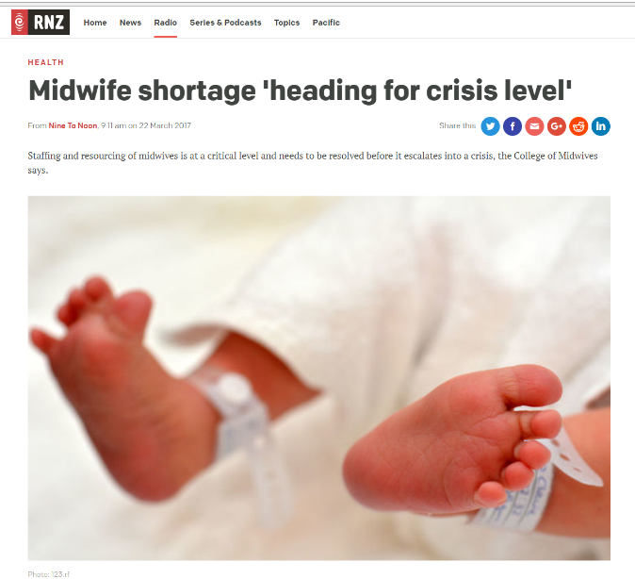
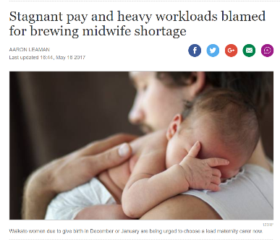
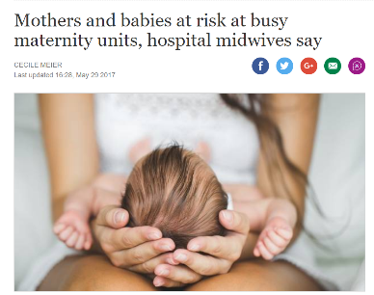
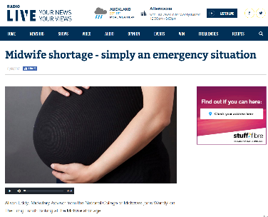
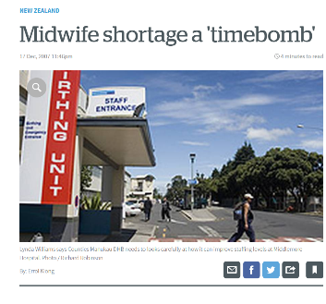

Slide 4
Perception of Midwife

Slide 5
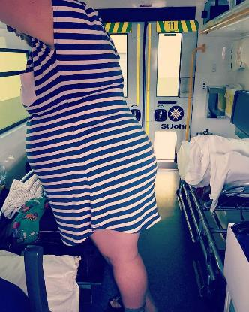
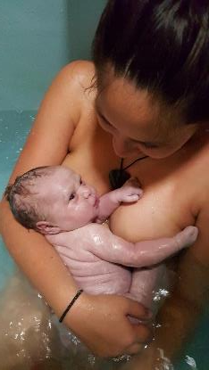
Reality of the Midwife
Urban and Rural

Slide 6
Representative Midwife Gross Fees per Woman under current Section 88
Low Capacity -Low Need Teen Mum , smoker but otherwise healthy $2,120 | Low Capacity - High Need Mum with multiple disadvantages $986
High Capacity - Low Need Mum in her 30s, urban, healthy, affluent $2,805 | High Capacity - High Need Well educated, affluent, Mum with mental illness $2,058
Result - Inequitable Distribution for the Woman and the Midwife

Slide 7
Snapshot of Some Key Numbers (Current)
Estimate of Annual Births under Community Midwives’ Care 52,000 | Current MOH S88 Midwife Spend for Estimated Annual Births and Other Services $118m
Average Rate per Birth/Other Services $2,269 or $102,105 Gross Revenue per annum(for estimated full time case load of 45) before Business Costs and On Call Acknowledgement | Average Hourly Rate for 1 FTE (before Tax) $42.02 before Business Costs and On Call Acknowledgement $12.80 after Business Costs and On Call Acknowledgement
Notes:
Per average birthing woman the amount is between $2000 and in additional there are separate payments included in the $118m for additional services not resulting in a birth

Slide 8
NZ Health Strategy

Slide 9
Key Mediation Statements
Redesign the new funding model under the governments recently agreed Pay Equity Principles.
The Ministry agreed that in order to enhance the relationship with the College it will enter into a MOU in relation to the clinical and workforce advice the College provides to the Ministry.
It agreed that this evaluation must consider systematic and historic undervaluation of the community LMC role.
It was agreed that the community LMC midwife role must be job sized and evaluated by a mutually agreed external evaluator.
It agreed that all Court affidavits (which include extensive evaluation of the role of the LMC midwives in comparison with GP’s) can go to the expert evaluator.

Slide 10
Co-design Process

Slide 11
PRINCIPLES
Supporting Best Outcomes for Woman, Babies and Midwifes
Freedom of Choice and Free Service to NZ Women
Fair and Equitable Pay (for work done)
Support Sustainable Safe Workforce
Partnership and Continuity of Care
Universal, Responsive and Autonomous offering to Women
Community Centred
Quality Professional Service
Notes:
Co design principles

Slide 12
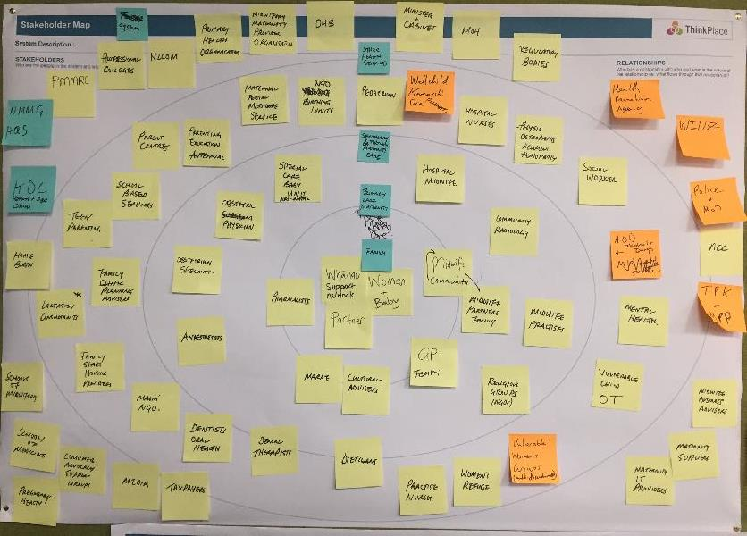
Snapshot – Level of Community Interaction
Notes:
Level of Integration

Slide 13
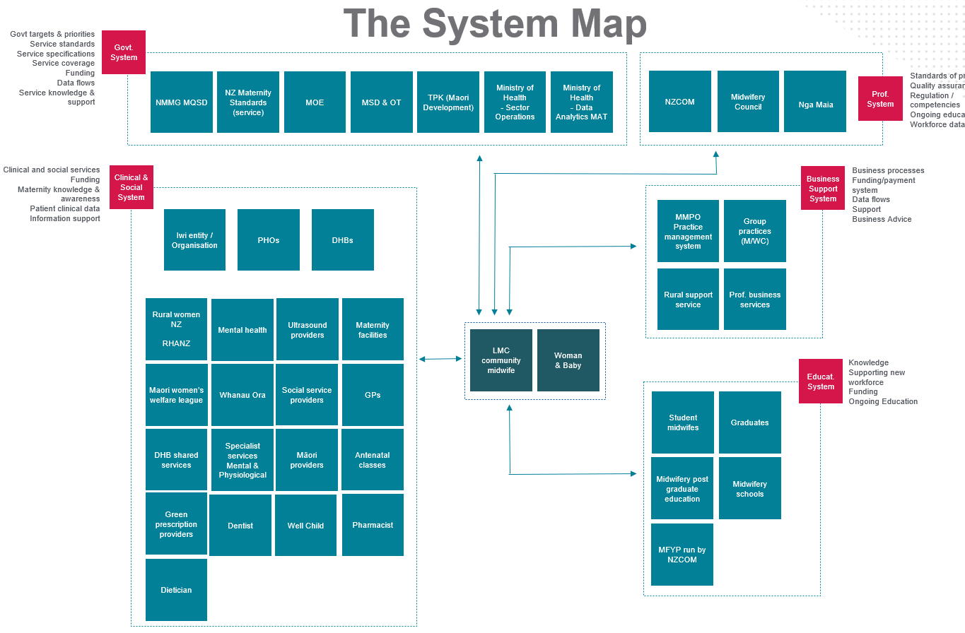
Snapshot – Level of integration
Notes:
Level of Integration

Slide 14
Community Primary Midwifery Funding Model Co-design
MoH
College of Midwives
Consumers
Co-design

Slide 15
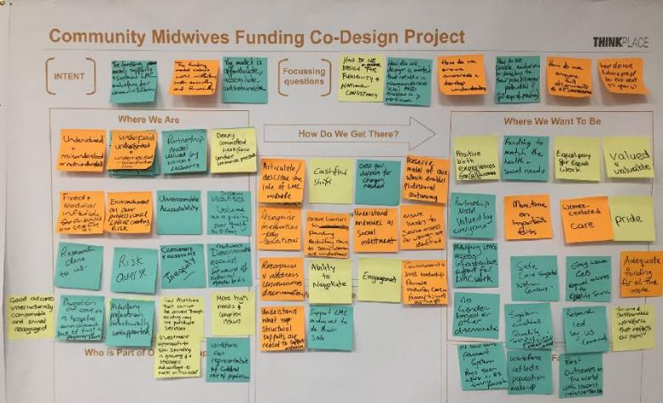
Project intent

Slide 16
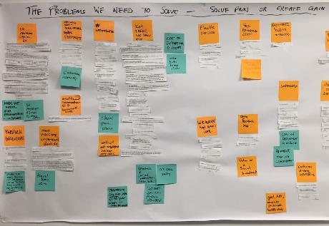
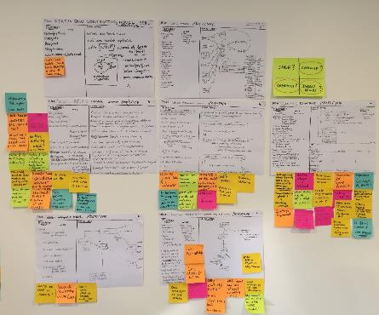
Developed early prototype ideas to achieve a better future

Slide 17
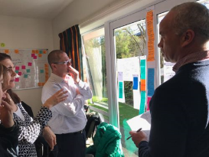
Refined and tested prototypes

Slide 18
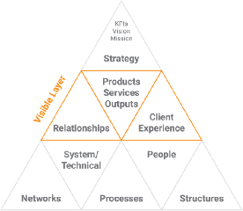
Prototype Test Lenses
OUTCOMES
What is desirable for users?
VIABILITY
The Sweet Spot
What is affordable or viable?
What is possible or feasible?
What is going to work for the organisation, for others? What is cost practical & sustainable?
FEASIBILITY
RISK
Strategy Layer
Risk
Identification
Risk
Assessment
Risk
Mitigation
Visible Layer
What are the critical vulnerabilities and credible threats or opportunities?
What is the likelihood and impact?
How to treat the risk with what? (Deter it, Detect it, or Deal with it?)
Capability Layer (Feasibility)

Slide 19
Community midwifery funding model prototypes
Payment Models Funding Models
Individual contracts with Ministry
Devolve to DHBs
National Provider
Modular fee for service
Salaries
Blended payment

Slide 20
Stakeholder engagement
National Maternity Monitoring Group
GMs, DHB Planning & Funding
Primary Healthcare Alliance
Royal Australian & New Zealand College of Obstetricians & Gynecologists

Slide 21
Co-design Overall
Recommendations

Slide 22
Community midwifery funding and payment recommendations
Payment Models Funding Models
Individual contracts with Ministry
Devolve to DHBs
National Provider
Modular fee for service
Salaries
Blended payment

Slide 23
Overall Co-design Recommendation
A National Community Midwifery Organisation that holds a national contract to support the workforce and fund contracted midwives via a Blended Payment Model that approximates the real costs of services and meets the highly variable needs of women and workforce.

Slide 24
National Community Midwifery
Organisation

Slide 25
Supporting
Workforce service delivery
Workforce data and reporting
Service data and reporting
Sustainability for service

Slide 26
Features of a National Community Midwifery Organisation
Nationally consistent structures, governance and infrastructure for midwives
Regional relationships to meet varying local need
Midwifery and consumer driven and governed
Would have experience, skills and knowledge to uphold and strengthen New Zealand Model of Care
Driven by social investment and demonstrated social outcomes
Responsible for quality assurance and service quality improvement
Responsible for national and regional service integration
Responsible for workforce support including locum service and IT infrastructure
Could be bulk funded and hold an outcomes based contract to drive innovation
Notes:
Commitment and Dedication Stability and Consistency
Rearrange Trsuted

Slide 27
Blended Payment Model

Slide 28
Features of a Blended Payment Model
Operating Costs
On Call Allowance
Additional time
Fee for service modules
(straightforward caseload)
Additional travel
Workforce incentives
Second midwife fee

Slide 29
Implementation plan for Community Midwifery
Year 0 (2017/2018)
Year 1 (2018/2019)
Year 2 (2019/2020)
Design and Plan
First payments made under Transitional Model
Improved access for families
Year 3 (2020/2021)
National Locum Service in place
Year 4 (2022/2023)
Representation growing
Integration growing
Equity improved for families
NMO Structures in place
NMO Functions agreed
System outcomes improving
Commence IT planning and implementation of payments model
MOU with College agreed
NMO fully operational
Future State
NMO potentially Bulk funded
Transitional NMO plan agreed
Budget Bid
Workforce Growth
Workforce Growth
NMR fully accessible
Blended payment model fully bedded in
Full IT driven Service Integration
Workforce and Outcomes Data and Reporting Improvement
Early Intervention Improved Positive Outcomes
Fully Operational National Maternity Record
Stable and Happy Workforce
PEOPLE POWERED
SMART SYSTEM
CLOSER TO HOME
ONE TEAM
VALUES AND HIGH PERFORMANCE
Workforce Stabilisation
Plan for National Maternity Organisation

Slide 30
Pricing

Slide 31
Pricing Approach
Remuneration for 1FTE: Comparators
- Resident Medical Officer
- General Practitioner
- DHB Employed Community Midwife
- 1993 & 1996 prices + inflation
Remuneration for unique on-call expectations: Comparators
- PRIME Rural GPs
- DHB Employed Community Midwife
- DHB Employed Core Midwife
Operating Costs: Comparators
- Actual costs research
- MOH 2012 LMC estimates
- Public Services estimates
Full time caseload
- Midwife Survey
- Time Tracker tool
- Midwifery best practice

Slide 32
Findings
Remuneration for 1FTE
$170,000 per annum
Remuneration for unique on-call expectations
$30,000 per annum
Operating Costs
$41,000 per annum
Full time caseload
40 women (av.)
2160 hrs per year
42 hrs per week

Slide 33
System cost
Caseload
Funding
x 1300 FTE
$313m
National Locum Service
$23m
Second midwife and single service episodes
$6m
Total cost
$353m
$6,800 per birth
Workforce incentives
$4m
Implementation and operating costs
$6.7m

