Slide 1
Title: Planning for palliative care services in Aotearoa: what our population data tells us
When: Tuesday 23 May 2023, 10.30am-12.30pm
Presenter: Heather McLeod, Actuary
Webinar: Teams Live event
Heather McLeod will present findings from updated studies of historical deaths and projections of deaths to 2043 and 2073. This is essential information for people with an interest in how we plan, fund and provide palliative care services in Aotearoa.
The presentation will include:
• The strategic challenges for palliative care
• The need for inpatient beds at the end of life
• Updated national trends for place of death
• How place of death varies with condition and the need for palliative care
• Māori and non-Māori differences and the impact of deaths at older ages
• New research on how place of death differs for urban and rural people
• A focus on regional trends and differences, with a tool to use for planning
As well as an opportunity to ask questions (via the Q&A function)
Heather McLeod is an actuary and academic whose work investigating palliative care data in Aotearoa for the Ministry of Health and Te Whatu Ora has informed policy and clinical directions since 2012.
The slides and a recording of this presentation will be available on the Te Whatu Ora palliative care webpage following the webinar. The supporting population projections, and the regional and district planning tool will be available during June.
Please email any questions about this live webinar to Phoebe Callanan (Team Administrator, Long Term Conditions) Phoebe.Callanan@health.govt.nz

Slide 2
Planning for palliative care services in Aotearoa what our population data tells us
23 May 2023
Heather McLeod, Actuary and academic

Slide 3
Strategic Challenges
Increased numbers of deaths

Slide 4
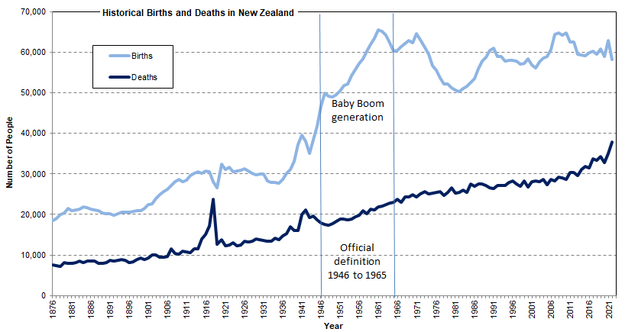
Births and Deaths in New Zealand 1876-2022
Entries to the world and exits from the world. Deaths have only recently exceeded 30,000 a year. Deaths will catch up to around the 60,000 level each year. Increase in 2022 deaths from COVID.
Data source: Stats NZ New Zealand cohort life tables: March 2023 update

Slide 5
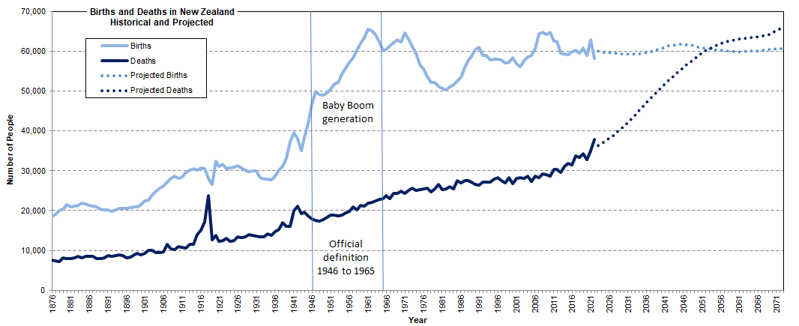
Births and Deaths in New Zealand 1876-2022 and projections to 2073
Entries to the world and exits from the world. Deaths have only recently exceeded 30,000 a year. Deaths will catch up to around the 60,000 level each year. Deaths projected to exceed births in 2050s.
Data sources: Stats NZ New Zealand Cohort Life Tables: March 2023 update; Stats NZ National Population Projections: 2022(base)–2073

Slide 6
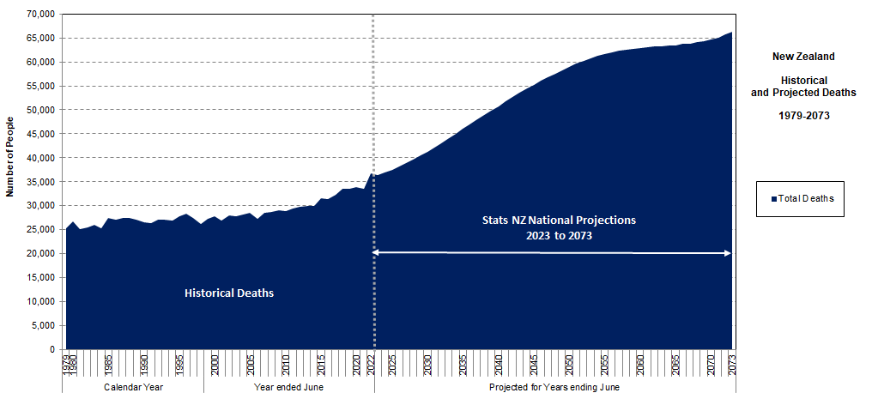
Total Deaths 1979-2073
The graph begins in 1979, the year of the first hospice in Aotearoa. National Projections are to 2073. These 50-year projections are useful for overall strategic direction and for workforce planning.
Data sources: Stats NZ Historical Deaths by age and sex (Annual-Jun; Annual-Dec); Stats NZ National Population Projections: 2022(base)–2073

Slide 7
Total Deaths 1979-2073
Stats NZ produces detailed projections to 2043 using Ministry of Health assumptions. The projections are updated annually, provide more detail by health district and ethnicity, and are used for planning in the health sector. “Update 2022” has slightly higher projected deaths than the national projections.
Data sources: Stats NZ Historical Deaths by age and sex (Annual-Jun; Annual-Dec); Stats NZ National Population Projections: 2022(base)–2073; DHB Births and Deaths Projections 2023-43 (2022 Update)

Slide 8
Commissioning
Increased numbers of deaths relative to population

Slide 9
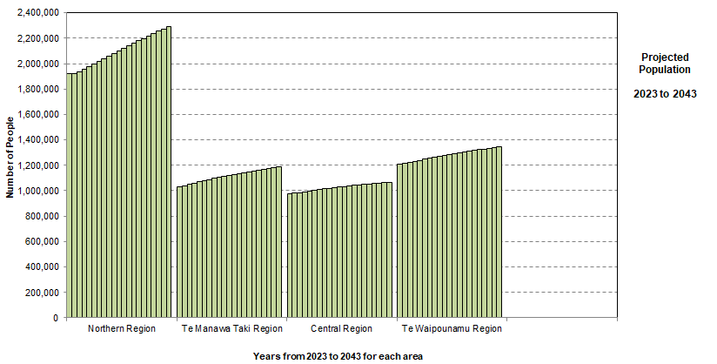
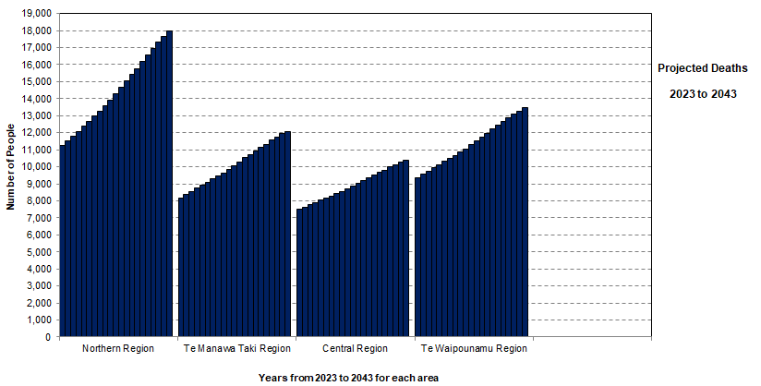
Regions 2023-2043
Population
Change in population from 2023 to 2043: New Zealand 115%
Northern 119%; Te Manawa Taki 115%; Central 109%; Te Waipounamu 111%.
Deaths
Change in deaths from 2023 to 2043: New Zealand 148%
Northern 160%; Te Manawa Taki 148%; Central 138%; Te Waipounamu 143%.
Data source: DHB Births and Deaths Projections 2023-43 (2022 Update)

Slide 10
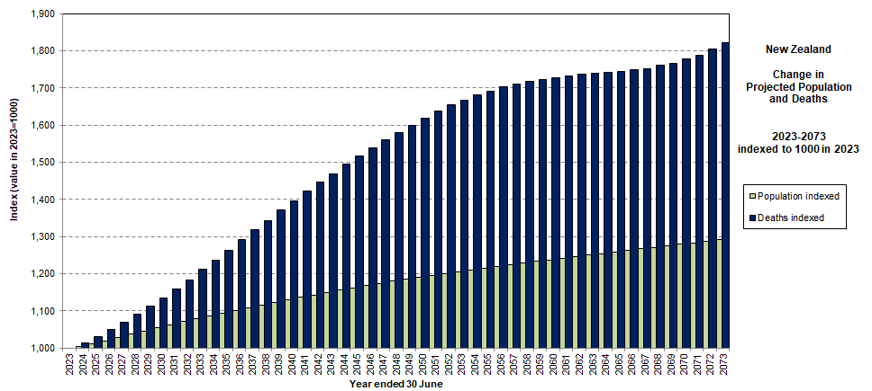
Increases in Population and Deaths 2023 to 2073
Deaths are increasing faster than population. If the values are indexed to 1000 in 2023, then by 2073 population reaches 1291 (increase of 129%) and deaths reach 1821 (increase of 182%).
Data source: Stats NZ National Population Projections: 2022(base)–2073

Slide 11
Commissioning for palliative care must be based on deaths and not population, because deaths are projected to increase much faster than the population.

Slide 12
Ethnicity
Births, Deaths and Population
2023-2043

Slide 13
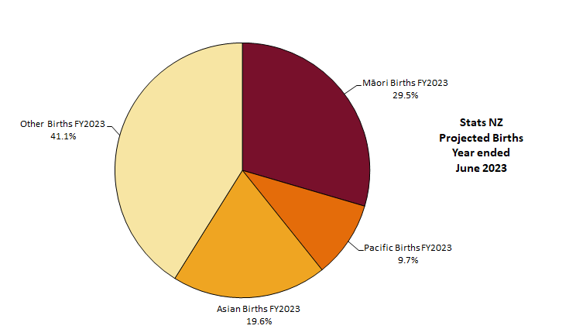
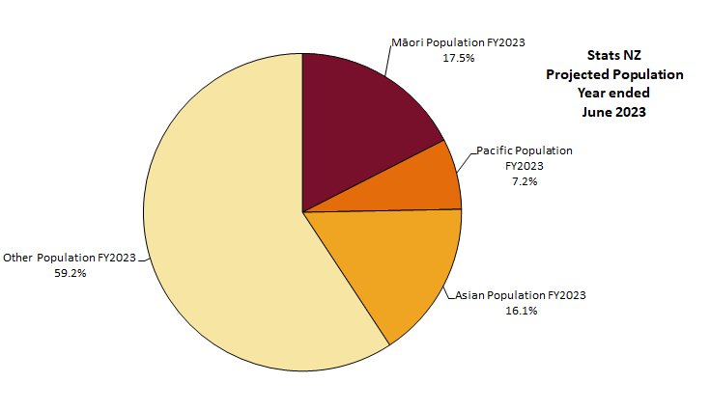
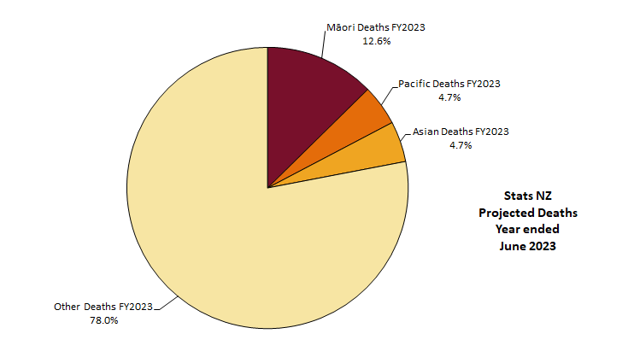
Ethnicity 2023
Births
Population
Deaths
Māori are 29.5% of total births, 17.5% of the population, and 12.6% of total deaths.
Māori and Pacific together are 39.3% of births, 24.7% of the population, and 18.4% of total deaths.
Data source: DHB Births and Deaths Projections 2023-43 (2022 Update)

Slide 14
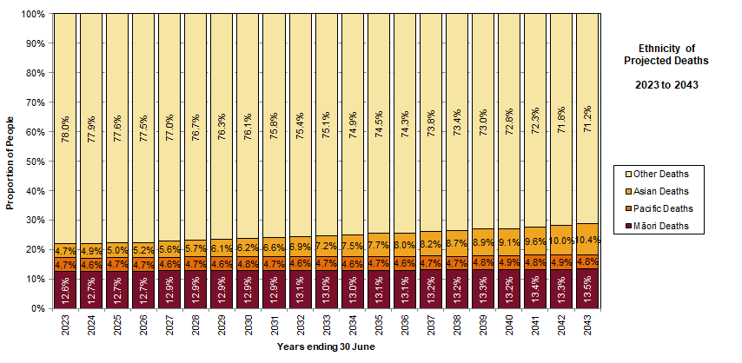
Ethnicity Deaths 2023 to 2043
Māori deaths as a percentage of total deaths are projected to increase from 12.6% in 2023 to 13.5% in 2043. The proportion of Asian deaths more than doubles over the period.
Data source: DHB Births and Deaths Projections 2023-43 (2022 Update)

Slide 15
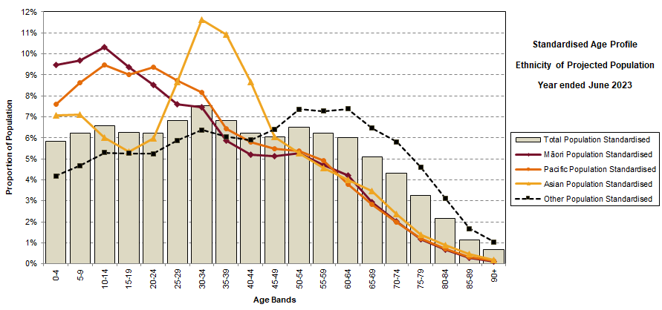
Ethnicity Age Profiles 2023
The four prioritised ethnicity groups have age profiles with very different shapes (standardised within each group). Māori and Pacific have very young populations, with a small tail at older ages. Other has fewer children and young adults, and a very “fat” elderly tail. Asian has an unusual bulge in the tertiary student and early working years.
Data source: DHB Births and Deaths Projections 2023-43 (2022 Update)

Slide 16
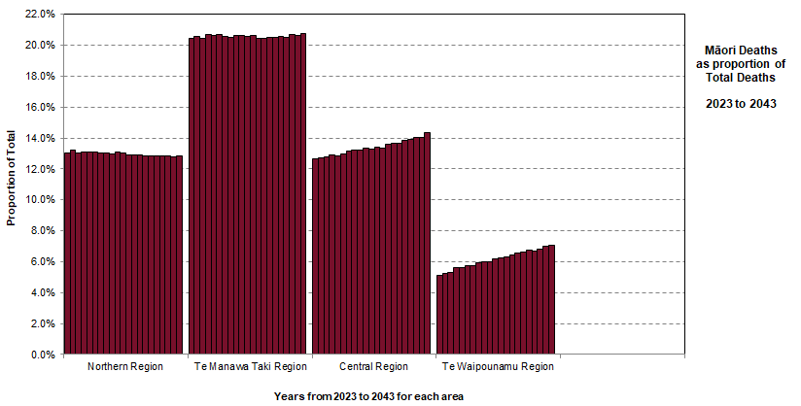
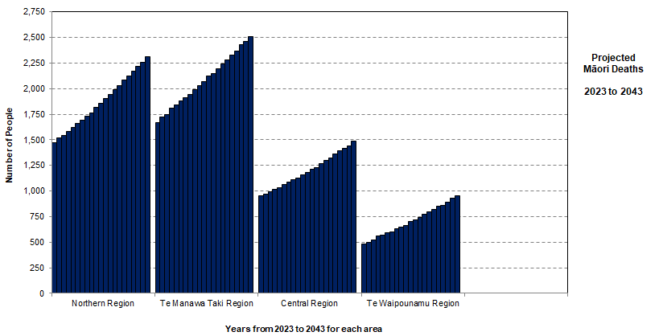
Māori as percent of Total Deaths 2023-2043
Patterns differ by region and over time.
Over the period, Māori deaths as a percent of Total deaths are projected to be roughly level for Northern and Te Manawa Taki but increase for Central and Te Waipounamu.
Data source: DHB Births and Deaths Projections 2023-43 (2022 Update)

Slide 17
Equity of palliative care delivery needs to be measured against the ethnicity of deaths and not the ethnicity of the population.

Slide 18
Strategic Challenges
Deaths at Older Ages

Slide 19
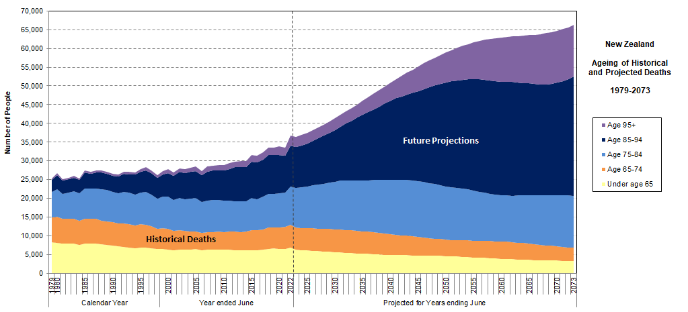
Ageing of Deaths 1979-2073
The challenge is not only the increasing number of deaths, but the ageing of deaths. Projected deaths are at significantly older ages than what the sector has experienced historically.
Data sources: Stats NZ Historical Deaths by age and sex (Annual-Jun; Annual-Dec); Stats NZ National Population Projections: 2022(base)–2073

Slide 20
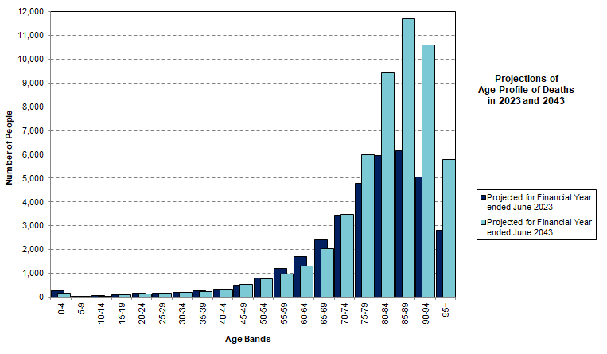
Ageing of Total Deaths 2023 and 2043
The ageing of projected deaths is a significant strategic challenge for palliative care.
Data source: DHB Births and Deaths Projections 2023-43 (2022 Update)

Slide 21
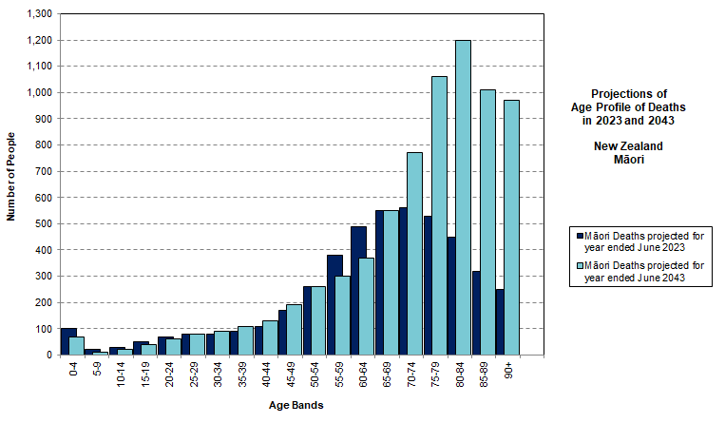
Ageing of Māori Deaths 2023 and 2043
The substantial ageing of projected deaths is a significant strategic challenge for palliative care for Māori whānau and communities.
Data source: DHB Births and Deaths Projections 2023-43 (2022 Update)

Slide 22
This is a major strategic challenge.
Not only will there be more deaths, but the deaths will be at much older ages.

Slide 23
Deaths at Older Ages
Implications for Palliative Care

Slide 24
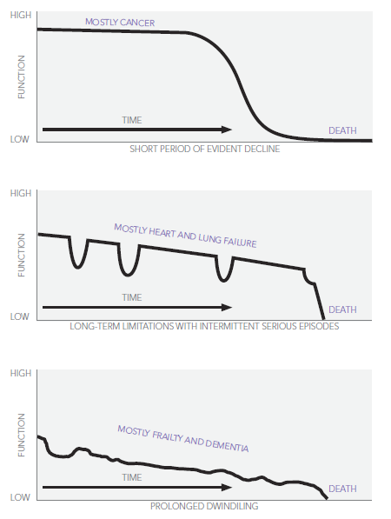
Trajectories at the End of Life
Peaks +/ age 65
Accidents - early adult years
The three characteristic trajectories illustrated are roughly sequential :
Cancer - peaking around age 65
Organ failure - about a decade later, around age 75
Frailty and dementia - those who live past their mid-80s.
Around age 75
Those who live past 85
Source: Palliative Care Australia (2010). Health System Reform and Care at the End of Life: a Guidance Document. 2010. Canberra: Palliative Care Australia.
Diagram from Lynn, J., & Adamson, D. M. (2003). Living Well at the End of Life. Adapting Health Care to Serious Chronic Illness in Old Age. 2003. RAND Health.
Notes:
“Trajectory 1 is characterised by a short period of evident decline over a period of weeks or months. Good function may be maintained for some time, with a few weeks or months of rapid decline as the illness becomes overwhelming and leads to death. Generally there is time to anticipate needs and plan for end of life care. While many diseases follow this course, it is typical of the major cancers.
This trajectory meshes well with traditional palliative care services that concentrate on providing comprehensive care over the last weeks or months of a person’s life. About 20 per cent of people will follow this trajectory.” [note these are not New Zealand figures]
“Trajectory 2 is characterised by long-term limitation of function with intermittent severe, acute episodes. Patients with heart failure or chronic obstructive pulmonary disease (COPD) are usually ill for many years. They frequently experience acute and often severe exacerbation of their physical symptoms.
These exacerbations are frequently associated with admission to hospital and intensive treatment. If patients survive an episode, they may well return home without much progression of their everyday disabilities. Patients usually survive many such episodes but at some point, rescue attempts fail. The timing of death is often a surprise in this group, despite their long-term chronic illness. Although many illnesses can follow this course, chronic heart failure and emphysema are the most common. About 25 per cent of people will follow this trajectory.”
Trajectory 3: Those who escape cancer and organ failure as they age will be likely to die of either dementia or generalised frailty. This trajectory is characterised by progressive disability from a baseline of already low cognitive or physical function. Gradual decline in functional capacity combined with the impact of often minor physical events—for example a fall or a respiratory or urinary infection—can prove fatal. Approximately 40 per cent of people will follow this trajectory.”
“The three characteristic trajectories described above are roughly sequential in relation to the ages afflicted, with illness trajectory 1 (cancer) peaking around age 65, fatal chronic organ system failure (trajectory 2) about a decade later and frailty and dementia (trajectory 3) afflicting those who live past their mid-eighties.”
[Palliative Care Australia (2010). Health System Reform and Care at the End of Life: a Guidance Document. 2010. Canberra: Palliative Care Australia.]
Diagram from Lynn, J., & Adamson, D. M. (2003). Living Well at the End of Life. Adapting Health Care to Serious Chronic Illness in Old Age. 2003. RAND Health. ]

Slide 25
Independent Life Expectancy New Zealand Study 1996–2013
Female New Zealander at 65 years of age in 2013 can expect to live:
another 10.6 years independently, on average, which is 49.5% of her remaining life
a further 10.7 years with functional limitations requiring assistance
non-daily assistance for 5.9 years
daily assistance for final 4.8 years.
Male New Zealander at 65 years of age in 2013 can expect to live :
another 10.2 years independently, on average, which is 54.1% of his remaining life
a further 8.7 years with functional limitations requiring assistance
non-daily assistance for 5.6 years
daily assistance for the final 3.1 years.
Source: Ministry of Health (2015) Independent Life Expectancy in New Zealand, 2013.

Slide 26
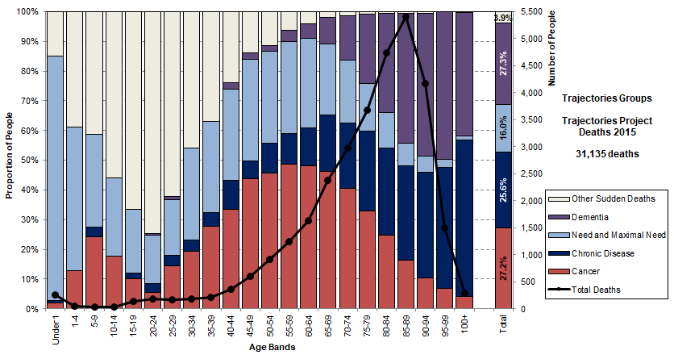
The Trajectories Study 2015
Intend to update and expand this study to 2015-2019
Trajectory Groups allocated sequentially: Dementia, Cancer (diagnosed cancer, died of neoplasm), Chronic Disease (needing ARC or interRAI assessment for home care), Need and Maximal Need (including Disability Support Services), Other Sudden Deaths.
Data Source: Trajectories Project, linked data for deaths in New Zealand in 2015
Notes:
The trajectories groups are extracted sequentially as follows:
Dementia: anyone with any evidence of dementia (MORT, hospital, medicines, interRAI diagnosis or Cognitive Performance Scale).
Cancer: no evidence of dementia, any cancer and died of neoplasm, or died of neoplasm (Cancer Registry, MORT).
Chronic Disease: no evidence of dementia, cause of death not neoplasm, any aged residential care subsidy or place of death residential care, or any interRAI. These are effectively the frail older people who need some assistance (ARC or assessed for home care).
Need and Maximal Need: all other causes of death that are included in the need for palliative care or the maximal need for palliative care. They may have chronic disease but are generally younger. Includes a young group receiving Disability Support Services if not already allocated.
Other Sudden Deaths: cause of death is not in maximal need for palliative care and not already allocated above.

Slide 27
The Changing Nature of Deaths
We used to die at the end of the first decade following retirement. “Fairly worn out, but quite happy.” Researchers call this the third age.
Now we may live and extra decade, two, or even three. Typically with “withering health and independence” after some kind of accident, usually a fall. May be hospitalised or cared for for weeks or months. This is the fourth age.
“[Y]ou will be very frail, possibly doubly incontinent, your sight, your taste, your hearing, your ability to orient yourself in time and space may all be severely compromised. You may be experiencing a lot of physical as well as emotional pain.”
What does palliative care look like when you are
90 and frail and have dementia?
Sources: Prof Tony Walter “The Revival of Death: two decades on”; Jana Kralova, “Living longer”, is that good news?
University of Bath, GW4 Dying Well Network. https://gw4dyingwell.wordpress.com/

Slide 28
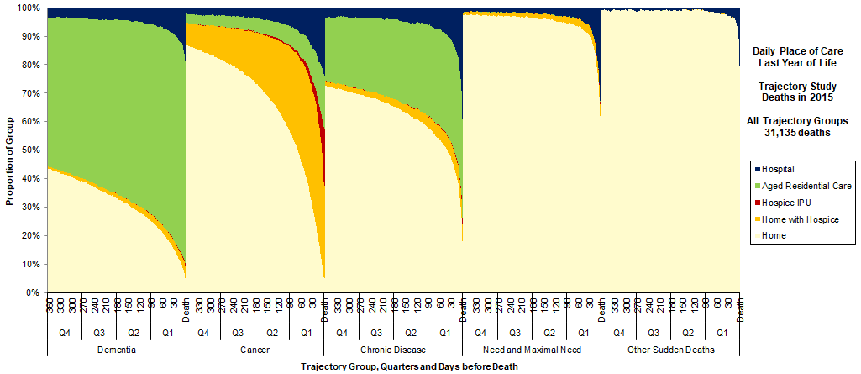
Last Year of Life by Trajectory Group
Daily place of care for each day in the last year of life (LYOL) for each of the five trajectory groups. Shown as a daily percentage of each group.
Data Source: Trajectories Project, linked data for deaths in New Zealand in 2015

Slide 29
Place of Death by Age Bands
Updated Evidence
MORT 2000-2018

Slide 30
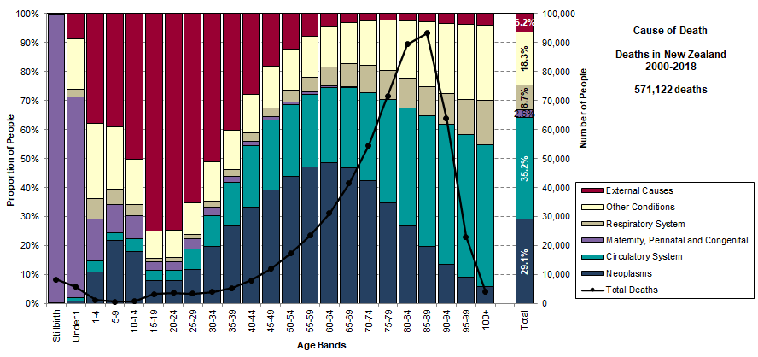
Cause of Death
This characteristic shapes by age have been known since the first study (2000-2010). In this 2000-2018 study, have separated out respiratory system deaths so that they can be compared to COVID deaths in later studies. Expecting a decline in respiratory system deaths in 2020 and 2021 lockdown, and then a partial replacement and overtaken by COVID deaths in 2022.
Data Source: MORT Study 2000-2018

Slide 31
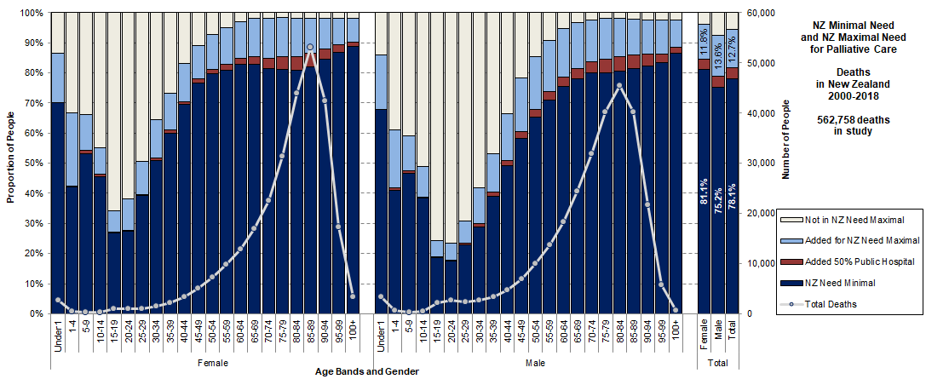
Need and Maximal Need for Palliative Care
This puts NZ Minimal Need and NZ Maximal Need together by age band and gender.
NZ Minimal Need (with the public hospital adjustment for Circulatory) should be considered the lower bound of the Need for Palliative Care. NZ Maximal Need is the upper bound of the Need for Palliative Care. There is a strong pattern for both by age and gender.
Data Source: MORT Study 2000-2018

Slide 32
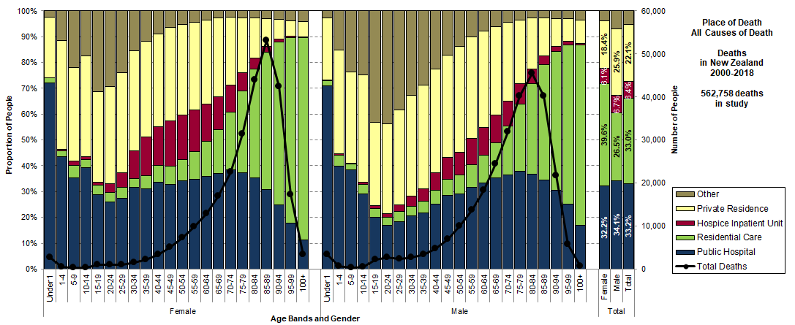
Place of Death by Age and Gender All Causes of Death
There is a strong and persistent pattern by age and gender for the place of death. Public hospital declines at older ages, with an expanding “green funnel” in residential care.
Data Source: MORT Study 2000-2018

Slide 33
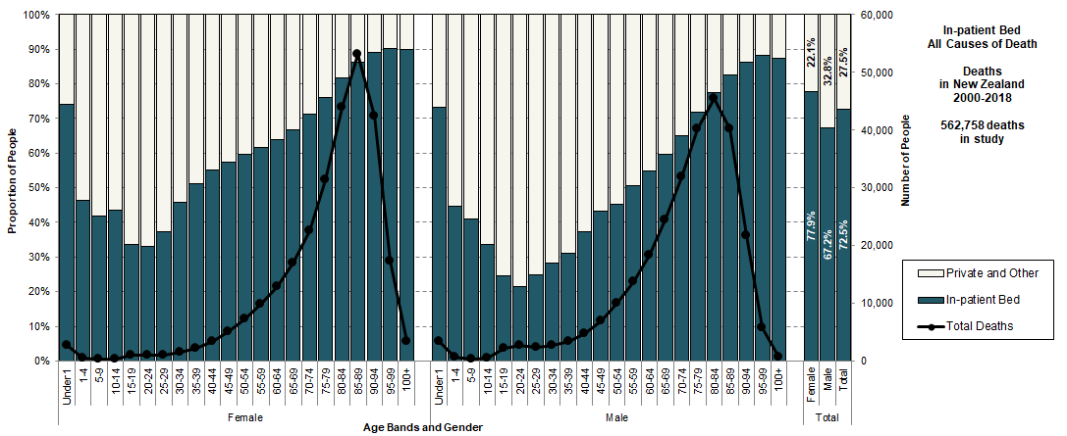
In-patient Bed by Age and Gender All Causes of Death
There is a strong and persistent pattern by age and gender for the use of an in-patient bed (public hospital or residential care or hospice IPU) at the end of life.
Data Source: MORT Study 2000-2018

Slide 34
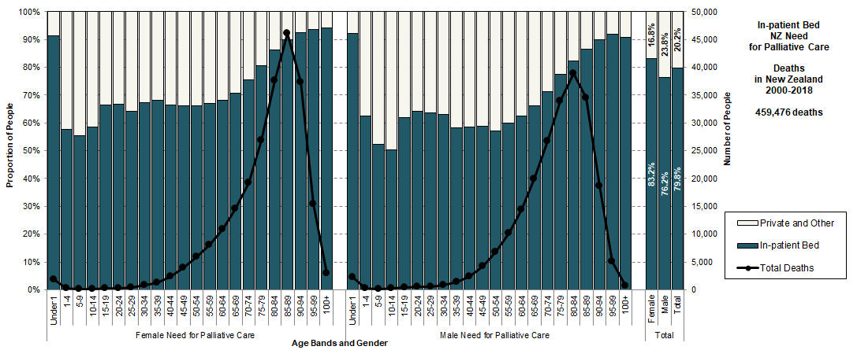
In-patient Bed by Age and Gender NZ Need for Palliative Care
The use of an in-patient bed becomes more “spoon-shaped” when only the deaths in the Need for Palliative Care are considered.
Data Source: MORT Study 2000-2018

Slide 35
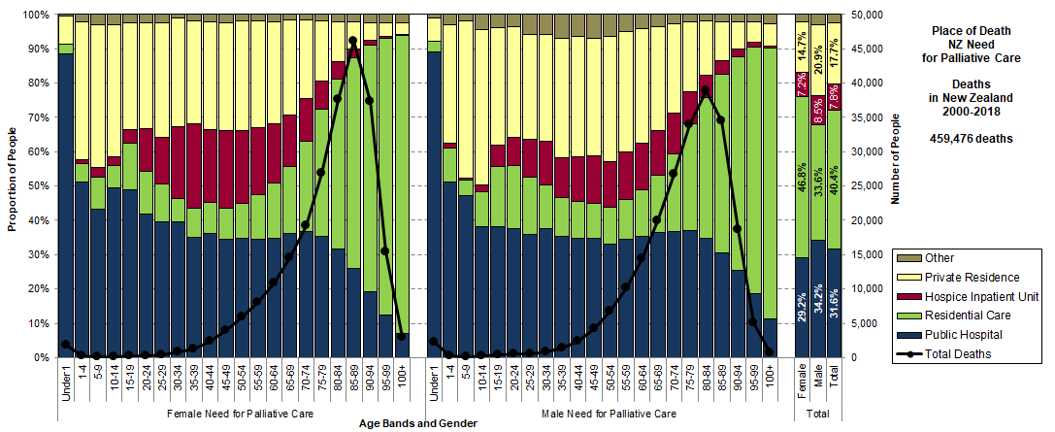
Place of Death by Age and Gender NZ Need for Palliative Care
The shapes change when only the deaths in the Need for Palliative Care are considered. Other settings are low for women and there is a greater proportion of hospice use in the breast cancer years. Residential care now includes some younger deaths.
Data Source: MORT Study 2000-2018

Slide 36
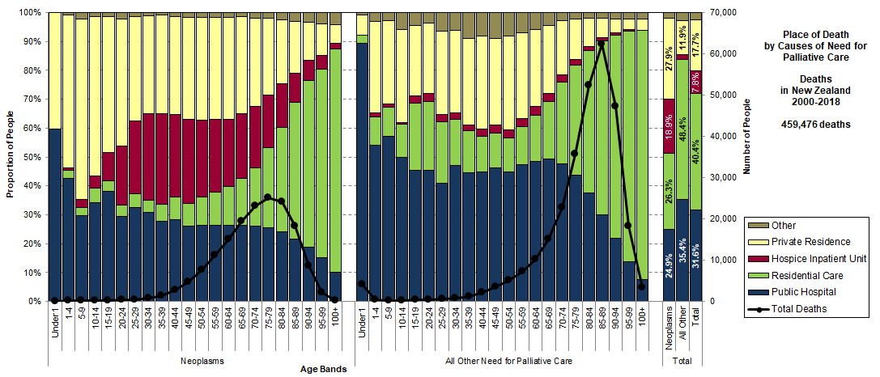
Place of Death by Age Band Cause of Need for Palliative Care
Comparing place of death for neoplasms and all other causes of death in the Need for Palliative Care. There are very different shapes by age, with much greater use of public hospital on the right.
Data Source: MORT Study 2000-2018

Slide 37
Trends in the Place of Death
Updated Evidence
MORT 2000-2018

Slide 38
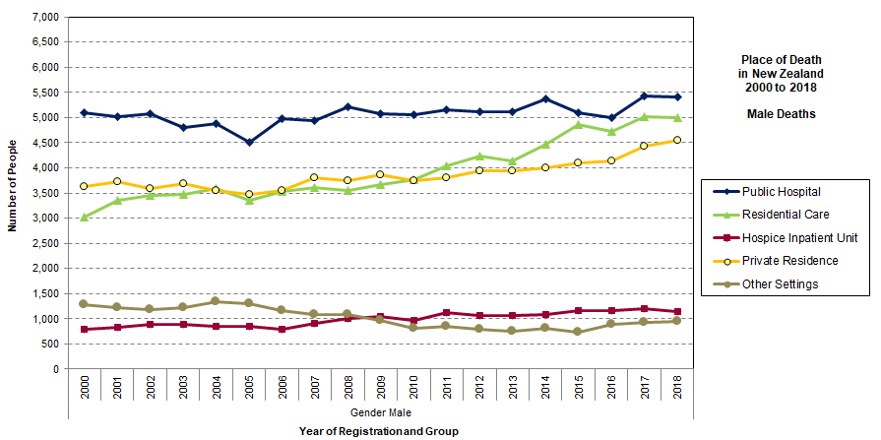
Place of Death in New Zealand Male Deaths, 2000-2018
Residential care has become an important place of death over the period, surpassing private residence in 2011 and tracking close to the level of deaths in public hospital since 2015. Includes all causes of death.
Data Source: MORT Study 2000-2018

Slide 39
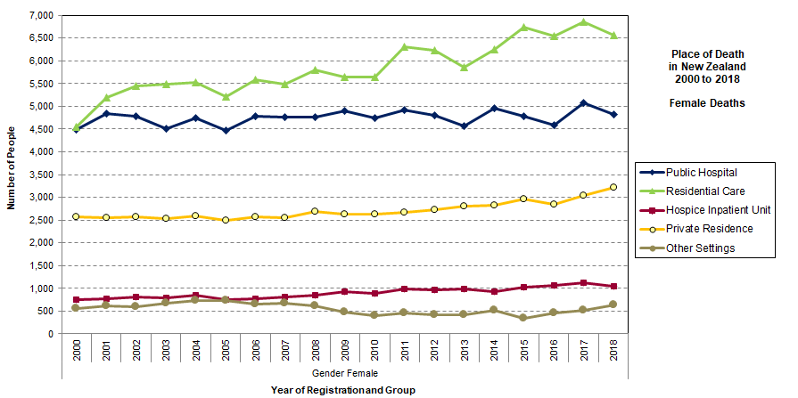
Place of Death in New Zealand Female Deaths, 2000-2018
Since 2001, residential care has been the most likely place of death for New Zealand women (all causes of death). The gap between residential care and public hospital continues to widen.
Data Source: MORT Study 2000-2018

Slide 40
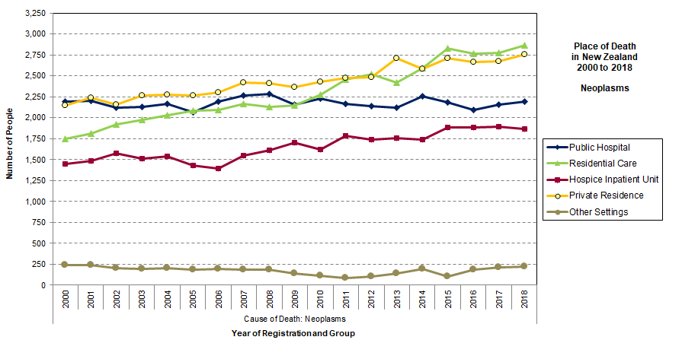
Place of Death in New Zealand Neoplasms, 2000-2018
Residential care has become an increasingly important setting for deaths from cancer, overtaking public hospitals in 2010 and tracking higher than private residence since 2015.
Data Source: MORT Study 2000-2018

Slide 41
The trend to increased numbers of deaths in residential care has been a key feature of the last twenty years.
Residential care has long been the most likely place of death for New Zealand women but is now also the most likely place of death for those with cancer.
It is close to becoming the most likely place of death for men (across all ages and causes of death).

Slide 42
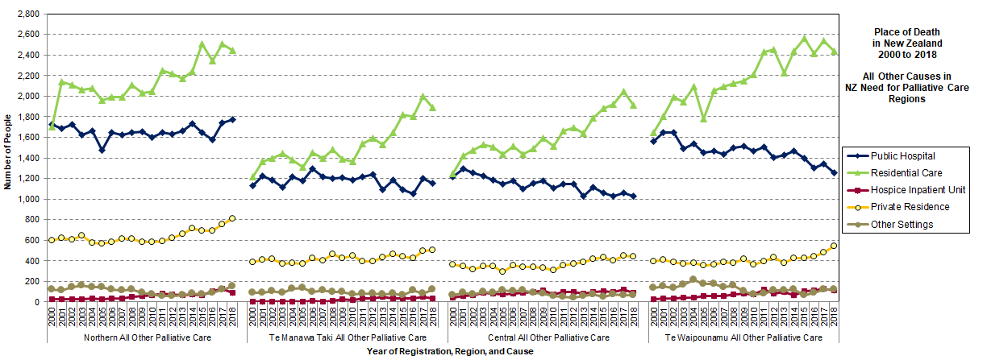
Place of Death All Other Palliative Care
For all other causes of death in the Need for Palliative Care, there has been a strong and sustained divergence between public hospital and residential care in all four regions (“crocodile jaws”). Central and Te Waipounamu have the widest divergence over time, with declining public hospital. All regions beginning to see an increase in private residence as place of death.
Data Source: MORT Study 2000-2018

Slide 43
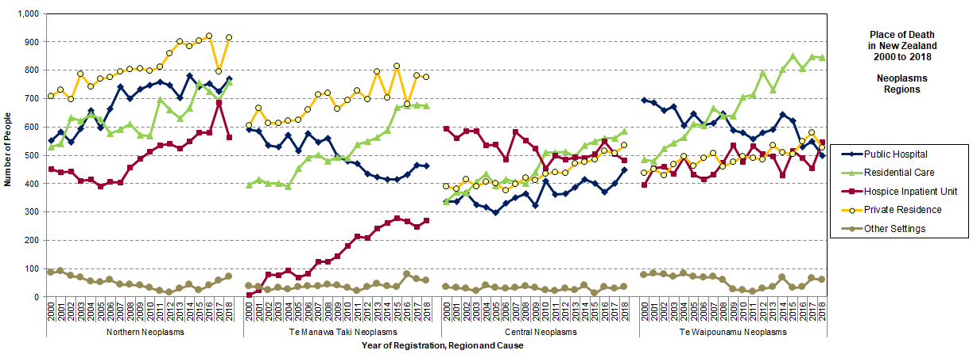
Place of Death Neoplasms
Hospice IPU as place of death for neoplasms varies substantially by region. Te Manawa Taki developed hospice IPU beds later than the other regions. Te Manawa Taki and Te Waipounamu have reducing use of public hospitals. All regions using residential care more heavily in the later years, with use greatest for Te Waipounamu.
Data Source: MORT Study 2000-2018

Slide 44
Large regional differences in place of death, particularly for cancer.

Slide 45
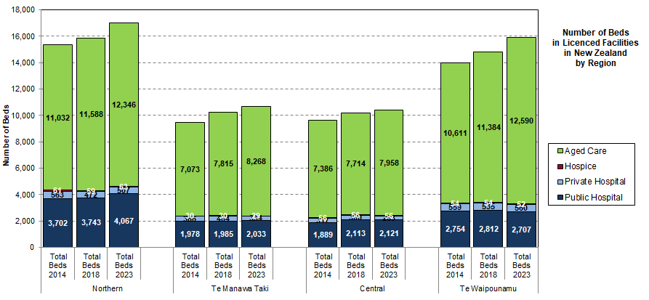
Licensed Beds by Region
There has been an increase in beds across all regions, with the increase largely in aged care beds.
Warning: these are licensed beds and not available or staffed beds.
Data Source: Manatū Hauora Licensed Beds, 2014, 2018, 2023

Slide 46
Hospice Community Care and IPU by Region
More community care
More IPU
There are different models of hospice care. Te Manawa Taki tends to use mostly community care, while Central has and uses more IPU beds. There could also be a rural-urban effect. Some Manawa Taki hospices do have IPU admissions, but to beds in other facilities, e.g. beds in Gisborne public hospital.
Source: Trajectories Project, linked data for deaths in Aotearoa in 2015

Slide 47
Māori Place of Death
MORT 2000-2018

Slide 48
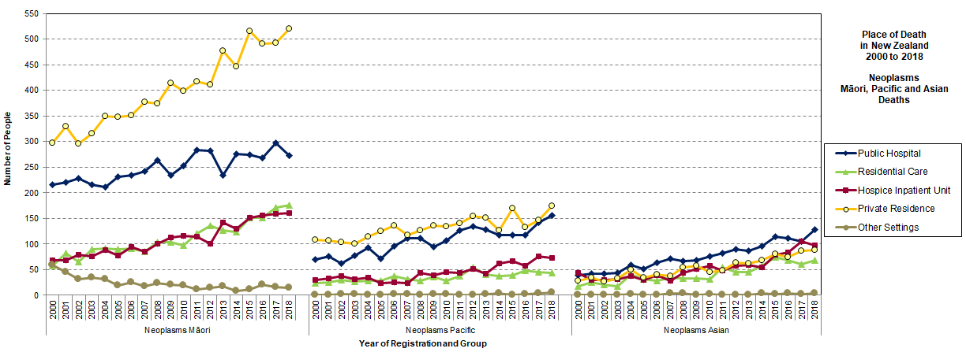
Place of Death in New Zealand Māori, Pacific, Asian Neoplasms, 2000-2018
Considering deaths from Neoplasms only, private residence, is significantly more likely as a place of death for Māori. Private residence exceeds public hospital for Pacific but is the reverse for Asian. Increases in hospice IPU for all groups, with similar levels in residential care.
Data Source: MORT Study 2000-2018

Slide 49
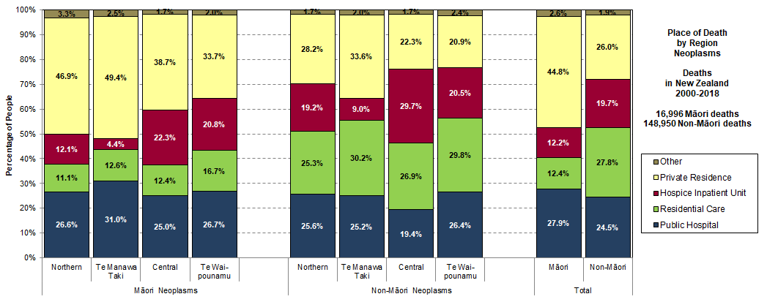
Māori Place of Death by Region, Neoplasms
Central makes most use of hospice IPU. Te Manawa Taki has a more community-based model of care and hospice IPU beds were developed during the period. In all regions, Māori make more use of private residence and less use of residential care.
Data Source: MORT Study 2000-2018

Slide 50
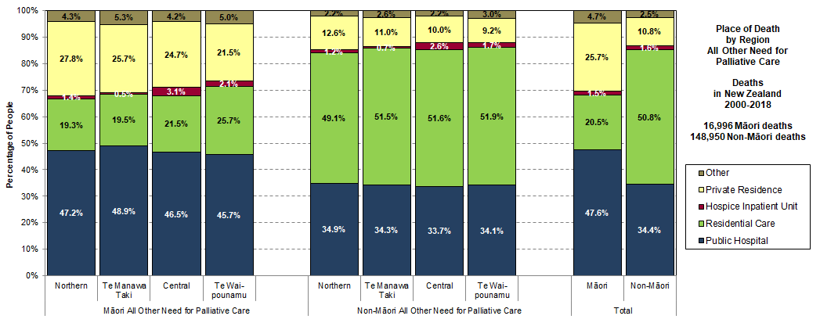
Māori Place of Death by Region, Other Need
In all regions, Māori make more use of private residence, more use of public hospital, and less use of residential care.
Data Source: MORT Study 2000-2018

Slide 51
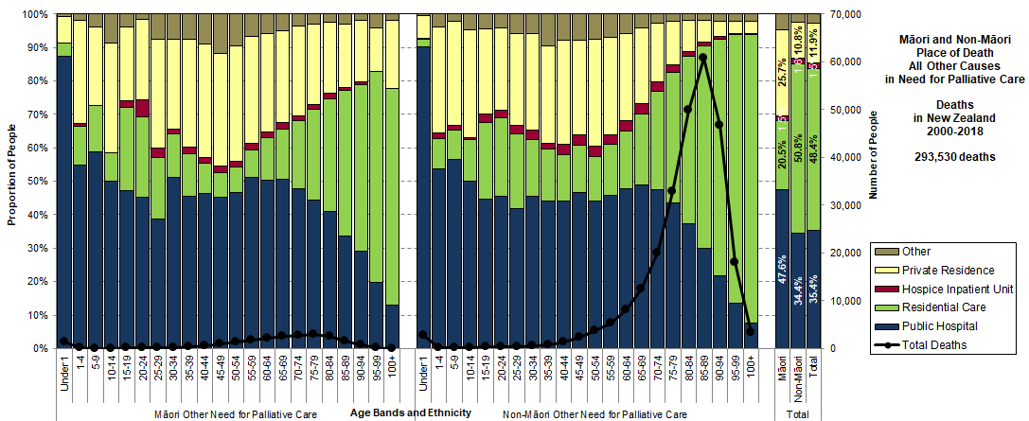
Māori Place of Death by Age Band Other Need for Palliative Care
Comparing Māori and non-Māori place of death for all other causes of death in the Need for Palliative Care. The elements of the shapes are remarkably similar by age band. Māori made proportionately more use of private residence in the late adult years.
Data Source: MORT Study 2000-2018

Slide 52
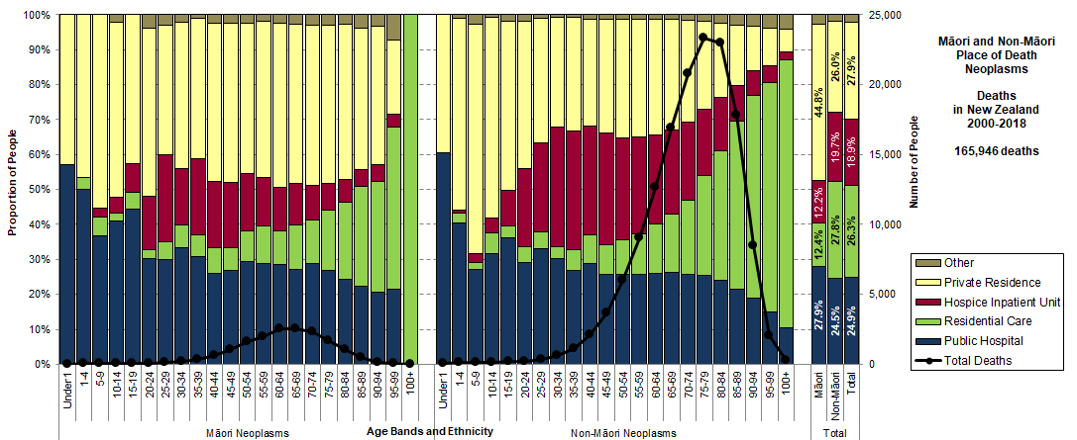
Māori Place of Death by Age Band Neoplasms
Comparing Māori and non-Māori place of death for neoplasms. The elements of the shapes are remarkably similar by age band. Māori made proportionately more use of private residence and less use of hospice IPU and residential care. NB This is only hospice IPU and not all hospice care.
Data Source: MORT Study 2000-2018

Slide 53
Beware – place of death studies only account for hospice IPU and not hospice care in the community.

Slide 54
Place of Care
Māori and non-Māori
Trajectories Study 2015

Slide 55
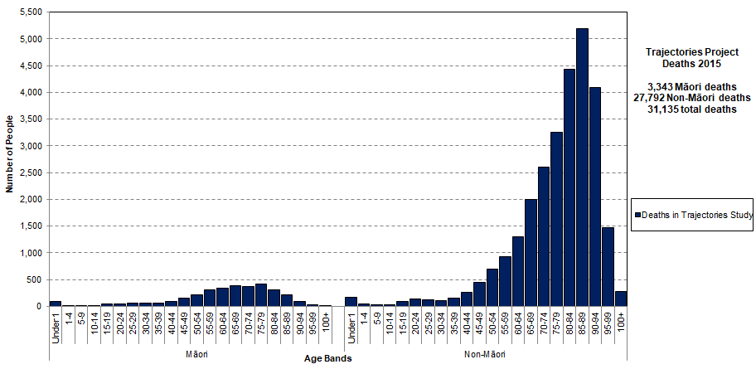
Deaths in Trajectories Study 2015
In total, there were 3,343 Māori deaths and 27,792 non-Māori deaths. Will compare Māori to Non-Māori patterns. There is 8.3 times as much data for patterns in the non-Māori group, so patterns will appear smoother on the right than on the left.
Source: Trajectories Project, linked data for deaths in Aotearoa in 2015

Slide 56
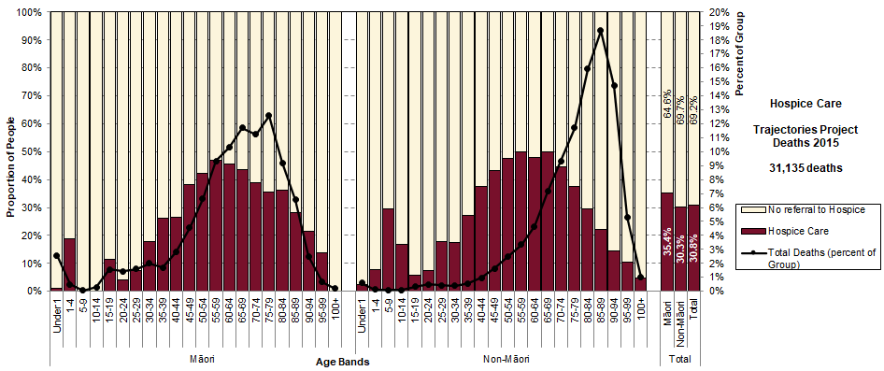
Use of Hospice Care
Very similar shapes. Peak is close to 50% in the “cancer years” but declines at older ages. The effect of the age at which the deaths occur is what changes the total percentage using hospice care.
Source: Trajectories Project, linked data for deaths in Aotearoa in 2015

Slide 57
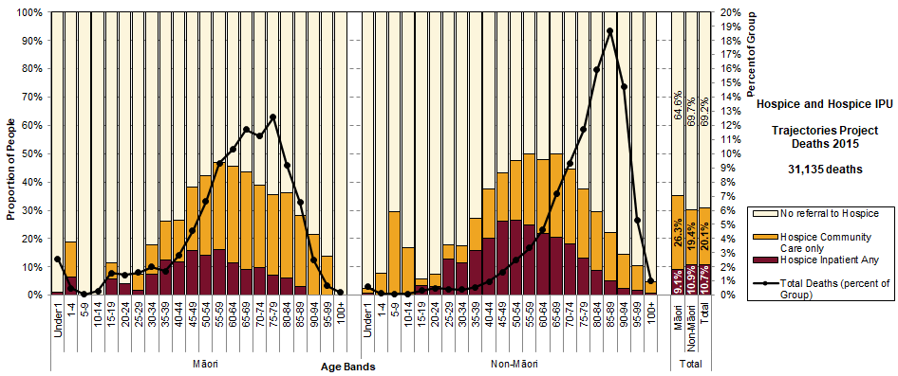
Use of Hospice Community Care and IPU
Use of Hospice IPU is an area where there is a real difference in the shapes, with Māori using more Hospice Community Care, and less Hospice IPU. Will examine the regional differences in model of care.
Source: Trajectories Project, linked data for deaths in Aotearoa in 2015

Slide 58
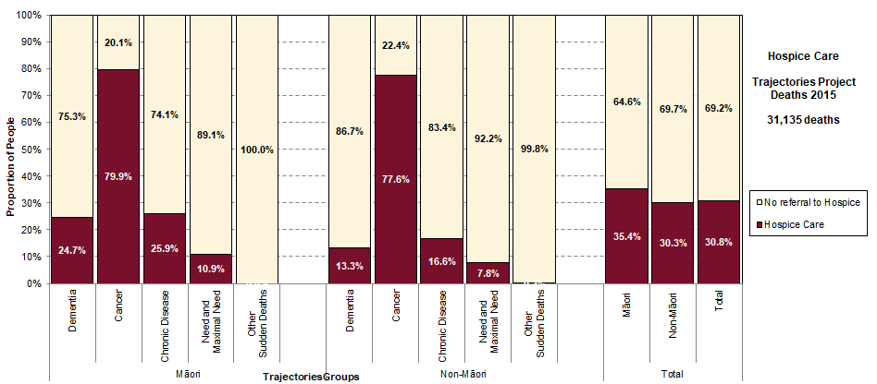
Use of Hospice Care by Trajectory Group
In all trajectory groups, Māori make more use of hospice care. The high proportion of Māori deaths in the Cancer group also increases the overall percentage use of hospice, which is 35.4% of all Māori deaths. This compares to 30.3% for non-Māori.
Source: Trajectories Project, linked data for deaths in Aotearoa in 2015

Slide 59
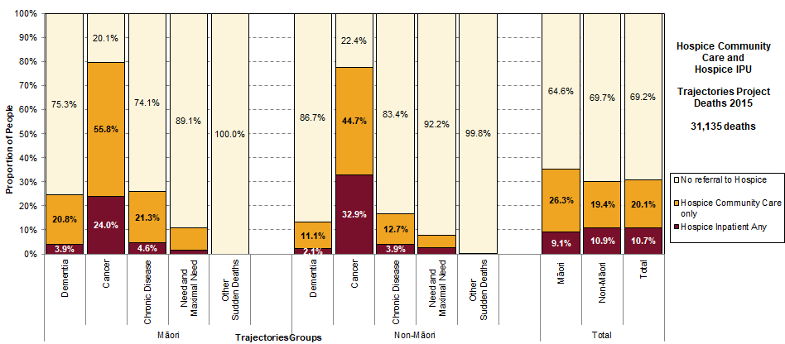
Hospice Community Care and IPU by Trajectory Group
The relationship between hospice community care and hospice IPU is different, with Māori making more use of hospice community care. As shown earlier, this is related to the regional availability of hospice IPU.
Source: Trajectories Project, linked data for deaths in Aotearoa in 2015

Slide 60
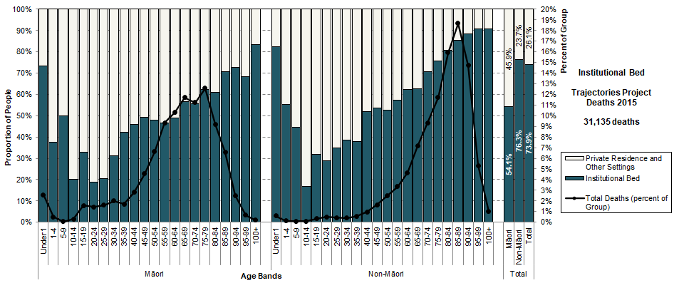
Institutional Bed for Place of Death
Similar features to shape, although for Māori in adult ages the angle is not as steep. In other words, somewhat less use of an institutional bed (public hospital, hospice IPU, or residential care) and more use of private residence and other settings.
Source: Trajectories Project, linked data for deaths in Aotearoa in 2015

Slide 61
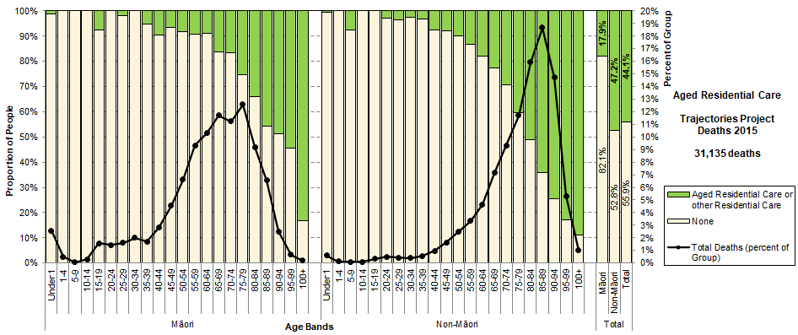
Māori Use of Aged Residential Care
Similar shape to the patterns. A scattered few before age 65. Strong increase with age, despite few deaths at the oldest ages for Māori. Perhaps a hint of keeping people at home longer?
Source: Trajectories Project, linked data for deaths in Aotearoa in 2015

Slide 62
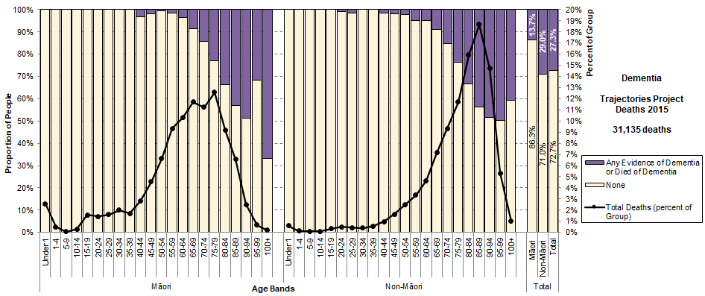
Māori Evidence of Dementia
Similar shape to the patterns. Only 6 Māori people at age 100+, but if combined with age 95-99, both patterns peak at about 50% at older ages. Pattern at age 100+ is adjusted to 50% for projections, as interRAI was undercounted in oldest people with dementia in 2015. interRAI only became compulsory in ARC from July 2015.
Source: Trajectories Project, linked data for deaths in Aotearoa in 2015

Slide 63
Place of care studies give us an understanding of how deaths at much older ages might evolve.

Slide 64
Place of Death Rural Equity
Geographical Classification for Health (GCH)

Slide 65
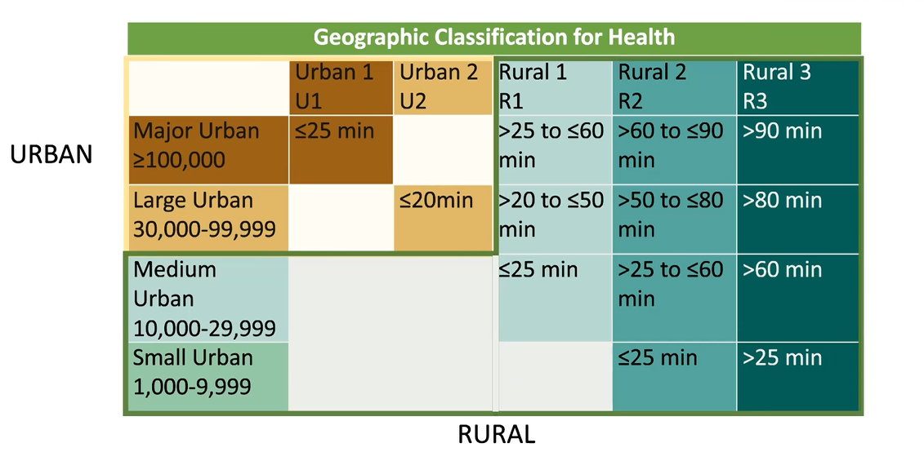
Geographical Classification for Health (GCH)
The classification is based on Stats NZ definitions of size of urban area, combined with drive times to those areas.
Produced for meshblock, SA1 and SA2 areas in 2018. Converted to domicile.
Source: Whitehead, J., Davie, G., de Graaf, B., Crengle, S., Fearnley, D., Smith, M., . . . Nixon, G. (2022). Defining rural in Aotearoa New Zealand: a novel geographic classification for health purposes. N Z Med J, 135(1559), 24-40. https://www.ncbi.nlm.nih.gov/pubmed/35999779

Slide 66
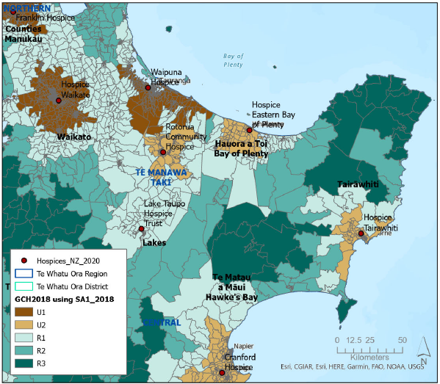
Te Manawa Taki GCH using SA1
GCH using SA1 is the “Gold Standard”.
National Collections often use domicile.
Analysis of MORT data 2000-2018 uses domicile.

Slide 67
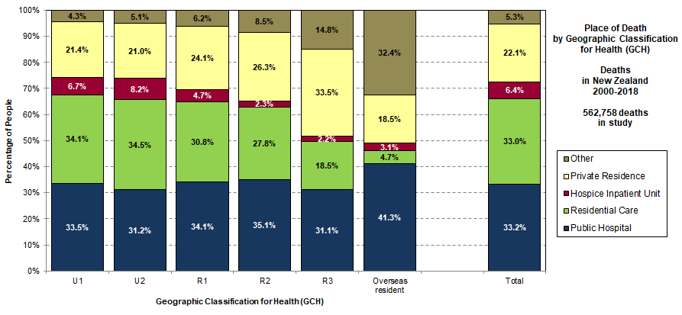
Place of Death and Urban-Rural GCH
The more rural, the lower the use of residential care and hospice IPU, and the higher the use of private residence and other settings.
Data Source: MORT Study 2000-2018

Slide 68
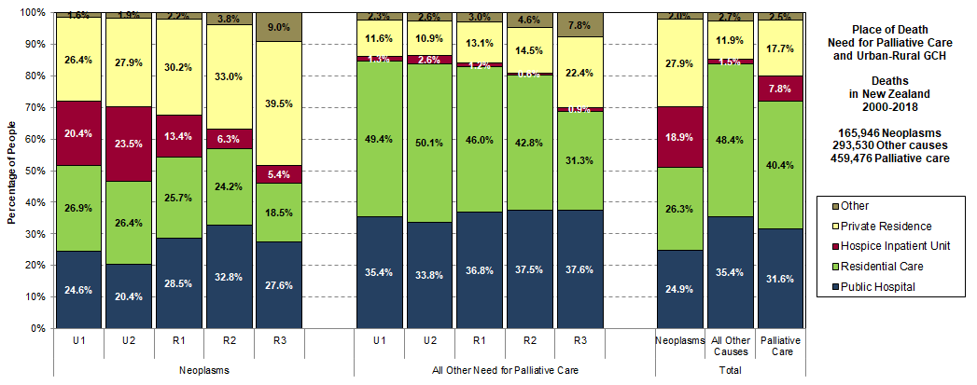
Place of Death, Need, and Urban-Rural GCH
The more rural, the lower the use of hospice IPU for neoplasms and of residential care for other Need. Public hospital use for neoplasms is highest for R2. The more rural, the higher use of private residence and other settings.
Data Source: MORT Study 2000-2018

Slide 69
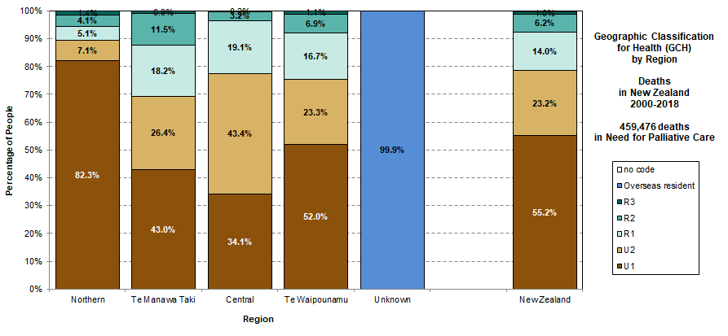
Urban-Rural GCH by Region, Palliative Care
Considering only deaths in Need for Palliative Care. There are significant differences by region. Northern has 82.3% of deaths in U1. Central has smallest proportion of U1 (34.1%) and the largest proportion of U2 (43.4%). Te Manawa Taki has the largest proportion of rural classifications (30.6%).
Data Source: MORT Study 2000-2018

Slide 70
Urban-Rural GCH by District
More detail on the significant differences by districts within regions.
Data Source: MORT Study 2000-2018

Slide 71
GCH and Place of Death, Other Need
For those dying of other causes in the Need for Palliative Care, the place of death differs by urban-rural and by region. For Te Manawa Taki and Central, the more deeply rural, the less likely death is in residential care and the more likely it is in public hospital or private residence. The more deeply rural the more likely death is in private residence in all regions.
Data Source: MORT Study 2000-2018

Slide 72
GCH and Place of Death, Neoplasms
For those dying of neoplasms, the place of death differs by urban-rural and by region. For Te Manawa Taki and Central, the more deeply rural, the more likely death is in public hospital. The more deeply rural, the less likely death is in hospice IPU. The more deeply rural the more likely death is in private residence, and this is strongest for Northern.
Data Source: MORT Study 2000-2018

Slide 73
Challenge to reduce differences by region and between urban and rural.

Slide 74
In-patient Beds
Needed at the end of life

Slide 75
In-patient Bed by Age Band Cause of Need for Palliative Care
Comparing in-patient bed for neoplasms and all other causes of death in the Need for Palliative Care. Both have increasing use of an in-patient bed at older ages. For younger deaths from neoplasms, more are able to die at home.
Data Source: MORT Study 2000-2018

Slide 77
Transitions on the Day of Death
Source: Animations from Trajectories Project, using linked data for deaths in New Zealand in 2015

Slide 78
Seasonality of Deaths
There is strong seasonality of deaths, with more deaths in winter and early spring. Peaks in July and August at 114% of average. The low deaths in February (85% of average) are due largely to it being a shorter month.
Data Source: MORT Study 2000-2018

Slide 79
Seasonality and Place of Death
Strongest winter seasonality for Public Hospital and Residential Care (both have peaks in July of 117% of average, August 116%). Gap between hospital and ARC seems to close in December. Not as much seasonal change for Hospice IPU (July 105% of average).
Data Source: MORT Study 2000-2018

Slide 80
“Bed-blocking”
Bed-blocking can happen here too.
Projections are for deaths to increase and to be at older ages.
This means proportionately more people in need of palliative care.
Staffing pressures on beds already licenced.
Are beds going to be available at the end of life?
Should we be putting more resources into community palliative care?

Slide 81
Last Year of Life by Trajectory Group
Daily place of care for each day in the last year of life (LYOL) for each of the five trajectory groups. Shown as a daily percentage of each group.
Data Source: Trajectories Project, linked data for deaths in New Zealand in 2015

Slide 82
Implications of Older Deaths
The major challenge for palliative care is that not only will the number of deaths be increasing, but they will be increasing in older age bands.
These deaths are likely to be occurring to people with more co-morbidities and a high prevalence of dementia.
If current patterns of end-of-life care continue most of these deaths over age 85 will occur in residential aged care facilities.
This challenges existing models of care.
This challenges the way end of life care is funded.
Impact on whānau and carers if beds not available and more care happens at home.

Slide 83
Impact on Whānau and Carers?
Source: Health Quality Ontario, 2016 http://www.hqontario.ca/System-Performance/Specialized-Reports/Caregiver-Distress-Report

Slide 84
Deaths at much older ages challenge existing models of care and challenge the way end of life care is funded.

Slide 85
Planning for the Next Twenty Years
Projected Deaths in Aotearoa 2023-2043
Available June 2023

Slide 86
Projections used for Models of Need
The projections have been used by the Ministry of Health for instructions to DHBs, and for the Population-based Funding Formula. Now produced for Te Whatu Ora. They are central to planning and funding – and hence are used in the projections for palliative care.
The models of need for palliative care and the projections they used:
Model of the Need for Palliative Care
DHBs Projected Deaths by Age and Sex for Years Ending 30 June 2015–38 (2013-Base) – 2015 Update
Projection Model for Trajectories at the End of Life
DHBs Projected Deaths by Age and Sex for Years Ending 30 June 2019–38 (2013-Base) – 2018 Update
Hospice NZ Direct and Indirect Support Model
DHBs Projected Deaths by Age and Sex for Years Ending 30 June 2021–43 (2018-Base) – 2020 Update
Te Whatu Ora Palliative Care Projection Model
DHBs Projected Deaths by Age and Sex for Years Ending 30 June 2023–43 (2018-Base) – 2022 Update
Used “Update 2015”
Used “Update 2018”
Used “Update 2020”
Uses “Update 2022”

Slide 87
Comparison of Projections Total Deaths Update 2015, 2018, 2020 and 2022
“Update 2015” and “Update 2018” used Base 2013 and had similar levels. There was a significant change when projections began to use Base 2018 after Census 2018. Total deaths in “Update 2022” are higher than “Update 2020”.
Data source: DHB Births and Deaths Projections 2023-43 (2022 Update)

Slide 88
Comparison of Projections Māori Deaths Update 2015, 2018, 2020 and 2022
“Update 2015” and “Update 2018” used Base 2013. There was a very significant increase in Māori deaths when projections began to use Base 2018 after Census 2018. Stats NZ also revised the 2013 estimates of Māori population. Total deaths in “Update 2022” are higher than “Update 2020”.
Data source: DHB Births and Deaths Projections 2023-43 (2022 Update)

Slide 89
Te Whatu Ora Palliative Care Projection Model
Projections by age band; projections by ethnicity
National, regional and districts by financial year to 2043
Phase 1
Statistics NZ
Projections of deaths using Manatū Hauora assumptions Twenty years: 2023 - 2043
to June 2023
“Update 2022”
Combines historical patterns with future projections
Spreadsheet model, choice of National, Region or District, Produces tables and graphs.
Trajectories Project
Linked data for all deaths in New Zealand occurring and registered in 2015.
Place of care.
MORT data (mortality),
Cancer Registry,
National Collections: NMDS, NNPAC, PRIMHD, Pharms, Labs, PHO, GMS
SOCRATES (Disability)
CCPS (ARC subsidies)
interRAI Assessments
Hospice Care, Hospice IPU
Te Whatu Ora Palliative Care Projection Model
Historical Patterns
for Trajectory Groups
Regional projections
and comparisons
Historical Patterns
by Trajectory Group
Only national patterns
National patterns by age band and Trajectory Group
Hospice Palliative Care Direct and Indirect Support Needed
Period for historical patterns
for the model is calendar 2015

Slide 90
The updated Te Whatu Ora Palliative Care Projection Model has detail on each region and district, using national patterns

Slide 91
Te Whatu Ora Palliative Care Projection Model
Projections by age band; projections by ethnicity
National, regional and districts by financial year to 2043
Phase 2
Statistics NZ
Projections of deaths using Manatū Hauora assumptions Twenty years: 2023 - 2043
to June 2024
“Update 2022”
Combines historical patterns with future projections
“Update 2023”
Spreadsheet model, choice of National, Region or District, Produces tables and graphs.
Trajectories Project
Linked data for all deaths in New Zealand occurring in 2015 to 2019 and registered before 2020.
Place of care.
MORT data (mortality),
Cancer Registry,
National Collections: NMDS, NNPAC, PRIMHD, Pharms, Labs, PHO, GMS
SOCRATES (Disability)
CCPS (ARC subsidies)
interRAI Assessments
Hospice Care, Hospice IPU
Te Whatu Ora Palliative Care Projection Model
Historical Patterns
for Trajectory Groups
Choice of national or regional patterns
Te Aka Whai Ora
Palliative Care Projection Model
Regional projections
and comparisons
Historical Patterns
by Trajectory Group
plus new data sets
National patterns by age band and Trajectory Group
Specialist Palliative Care Direct and Indirect Support Needed
Paediatric Palliative Care
Period for historical patterns
for the model is calendar 2015 to 2019
Patterns by region
National patterns for Māori

Slide 92
With a Trajectories Study over a five-year period (2015-2019), we can build better regional models and a separate Te Aka Whai Ora Palliative Care Projection Model

Slide 93
Body, Mind, Soul
Earth
Heather McLeod
Heather McLeod & Associates Ltd
Adjunct Professor, Actuarial Science, University of Cape Town
Extraordinary Professor, Department of Statistics and Actuarial Science, University of Stellenbosch
heather@heathermcleodnz.com

Slide 94
Ngā mihi nui
Jo Hathaway
Senior Advisor – Palliative Care
Long Term Conditions
īmēra: Jo.Hathaway@health.govt.nz
Ōtautahi Christchurch
Stephanie Read
Programme Manager – Palliative Care
Long Term Conditions
īmēra: Stephanie.Read@health.govt.nz
Ōtepoti Dunedin

Slide 95
Kōrero

