Slide 1
End to end journey
AIR Cutover Series – Session 5

Slide 2
AIR | Cutover Series Five Agenda
1
Session 1 - Consumer onboarding
2
Session 2 - Vaccination events
The AIR journey
What have we discussed and how does this support a vaccination journey?
1
3
Session 3 - Visualisation
2
Integration over time
How does this fit? What does this mean for AIR moving forward?
4
Session 4 - Integration
5
3
What does cutover look like?
What is cutover and what does this look like for me?
Session 5 - End to end journey

Slide 3
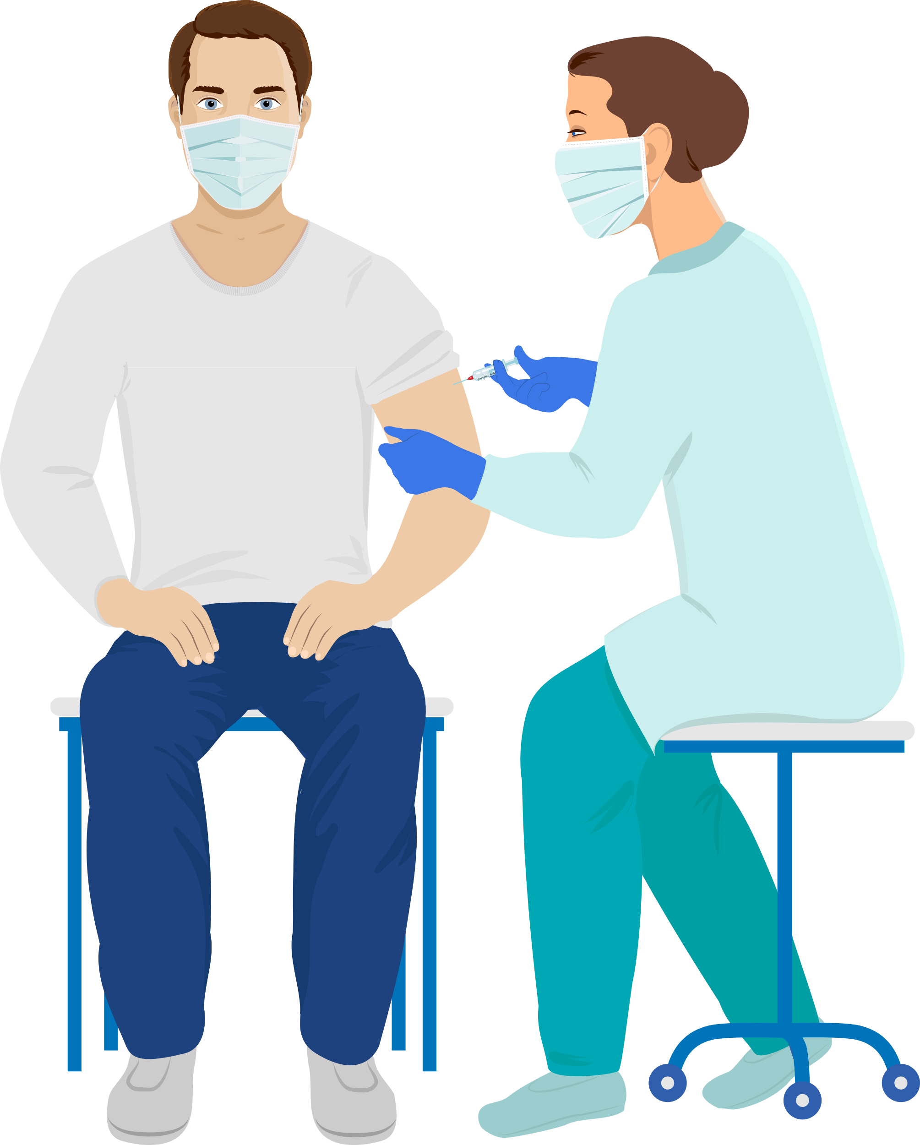
AIR | Future State – Immunisations Service
Below outlines a view of the AIR future state that supports the national immunisation service and public health responses. Users will connect to AIR using either an integration pathway (by connecting their primary application to ImmSoT) or via our direct channel – the Vaccinator Portal.
INTEGRATION SUITE (OPPORTUNITY TO BUILD YOUR OWN CHANNEL & COEXISTANCE)
REPORTING
IMMUNISATIONS SERVICE
IMMSOT
CONSUMER CHANNEL
AIR VACCINATOR PORTAL
(OFFLINE ENABLED, AND WORKFLOW)
AIR ADMIN SYSTEM
* Illustrative diagram

Slide 4
AIR | Future State – Immunisations Service
Below outlines a view of the AIR future state that supports the national immunisation service and public health responses. Users will connect to AIR using either an integration pathway (by connecting their primary application to ImmSoT) or via our direct channel – the Vaccinator Portal.
Used by the sector to access different levels of vaccination data
Used by the sector to support applications talking to each other
INTEGRATION SUITE (OPPORTUNITY TO BUILD YOUR OWN CHANNEL & COEXISTANCE)
REPORTING
IMMUNISATIONS SERVICE
Used by consumers to access their own Immunisation records
IMMSOT
CONSUMER CHANNEL
AIR VACCINATOR PORTAL
(OFFLINE ENABLED, AND WORKFLOW)
Used by the sector to record and view immunisations through a direct channel
Used to store vaccination records
AIR ADMIN SYSTEM
Used by the AIR Admin workforce to manage records and users
* Illustrative diagram

Slide 5
The AIR Journey

Slide 6
AIR | Our AIR Journey
People will interact with health and vaccination services throughout their lifetime.
People have an expected set of vaccination interactions in line with the national immunisation schedule.
They are likely to need health services throughout their lifetime
A person is born in Aotearoa New Zealand.
People have received vaccinations and had these interactions recorded in an immunisation register. Vaccinators are also required to keep records.
We need immunisation records to be assigned to the right person and reflective of the actual vaccination interaction that took place
Against that population source we can see what immunisations people are expected to have and what they have had.
People want to know which vaccinations they have received and when

Slide 7
AIR | Our AIR Journey
People will interact with health and vaccination services throughout their lifetime.
People have an expected set of vaccination interactions in line with the national immunisation schedule.
They are likely to need health services throughout their lifetime
A person is born in Aotearoa New Zealand.
POPULATION SOURCE
People have received vaccinations and had these interactions recorded in an immunisation register. Vaccinators are also required to keep records
We need immunisation records to be assigned to the right person and reflective of the actual vaccination interaction that took place
Against that population source we can see what immunisations people are expected to have and what they have had.
People want to know which vaccinations they have received and when

Slide 8
A person is born in Aotearoa New Zealand.
POPULATION SOURCE
AIR |Population Source
AIR will not maintain a siloed set of the population like NIR, it will integrate to other source of truth systems such as the National Health Index
ISSUES BEING ADDRESSED
NIR only captures a subset of the population
Current system requires intensive administration effort to create and maintain consumer records
NIR maintains data in a silo and duplicates demographic information that is needed to support other health services
Aotearoa Immunisation Register
WHAT IS CHANGING
The AIR regularly scans NHI to update demographic details and to import new NHIs to creates new consumer records
When receiving a record from a PMS, AIR automatically matches that to an NHI to create the consumer record
If a user searches for an NHI that does not exist in AIR, AIR will retrieve that NHI to create the consumer record
AIR searches for new NHIs for u18s and updates daily
AIR gets record from PMS and matches and imports
AIR user searches for NHI, if not in AIR, AIR imports NHI
THE BENEFITS
A more consistent and reliable view of the population and demographic details as AIR regularly sweeps NHI.
Automated process which reduces admin burden to create consumers in the system.
Aligns to Te Whatu Ora's digital and data strategy to create effective and efficient tools that enable various programmes of work

Slide 9
AIR | Our AIR Journey
People will interact with health and vaccination services throughout their lifetime.
People have an expected set of vaccination interactions in line with the national immunisation schedule.
They are likely to need health services throughout their lifetime
NEWBORN
ENROLMENT
A person is born in Aotearoa New Zealand.
People have received vaccinations and had these interactions recorded in an immunisation register. Vaccinators are also required to keep records
We need immunisation records to be assigned to the right person and reflective of the actual vaccination interaction that took place
Against that population source we can see what immunisations people are expected to have and what they have had.
People want to know which vaccinations they have received and when

Slide 10
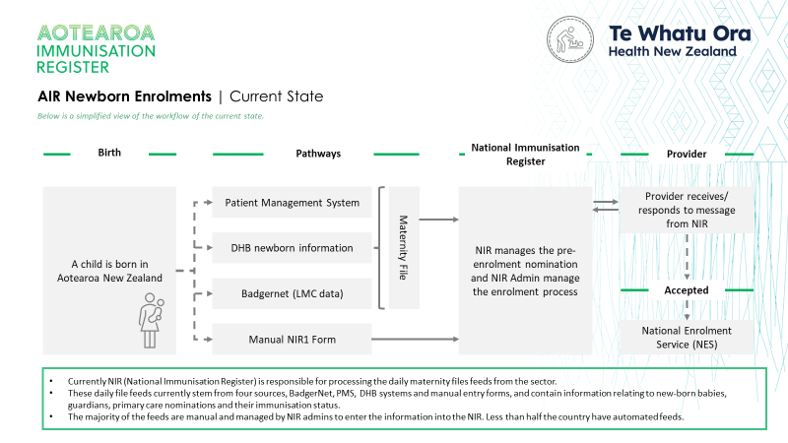
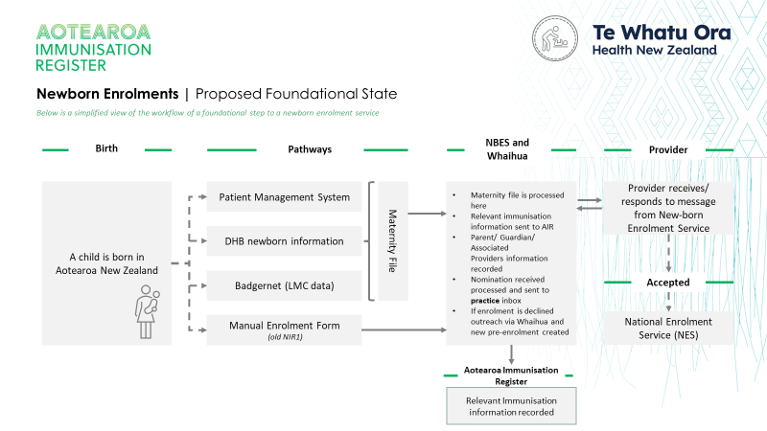
They are likely to need health services throughout their lifetime
NEWBORN ENROLMENT
AIR | Newborn Enrolment
The outcome will continue to be the same as we change the technology underneath, the experience, and pathway to do it.
ISSUES BEING ADDRESSED
Newborn enrolment is currently built into the NIR. This is problematic when considering other components of the health sector. Current system requires intensive administration effort to create and maintain consumer records
Newborn enrolment needs to be decoupled from immunisation so it can benefit all prevention programmes
WHAT IS CHANGING
Introducing a new, independent but integrated platform for newborn enrolment processes
Reorientating pre-enrolment to be centred on the person not just immunisation
THE BENEFITS
Business ownership for newborn enrolment shifts within the scope of the national enrolment service rather than dependent on immunisation technology
Manual processes to facilitate enrolment will sit within a shared platform centred on the consumer rather than within immunisation
We are enabling a more long-term view for enrolment which can be utilised by other areas of the health sector
Newborn enrolment will be decoupled from Immunisation - For more on this please see cutover series session 1
*No initiative currently scopes this activity

Slide 11
AIR | Our AIR Journey
People will interact with health and vaccination services throughout their lifetime.
People have an expected set of vaccination interactions in line with the national immunisation schedule.
PLANNED EVENTS
They are likely to need health services throughout their lifetime
A person is born in Aotearoa New Zealand.
People have received vaccinations and had these interactions recorded in an immunisation register. Vaccinators are also required to keep records
We need immunisation records to be assigned to the right person and reflective of the actual vaccination interaction that took place
Against that population source we can see what immunisations people are expected to have and what they have had.
People want to know which vaccinations they have received and when

Slide 12
People have an expected set of vaccination interactions in line with the national immunisation schedule.
PLANNED EVENTS
AIR | Planned Events
Planned Events are the list of anticipated immunisation events against the National Immunisation Schedule to support proactive immunisation of our population.
ISSUES BEING ADDRESSED
The NIR currently operates in tasks. Within tasks it is hard to distinguish what did happen from what was supposed to happen.
Tasks are limiting in the information they provide to providers involved in vaccinations
Changes to the national immunisation schedule lead to considerable work and are often delayed in hitting the sector
Consumer Planned Events
Expected Events
Provider Planned Events
WHAT IS CHANGING
Planned Events are the list of anticipated immunisation events against the National Immunisation Schedule to support proactive immunisation of our population.
Planned Events will be visible to all providers involved with vaccination who consume the API or use the Vaccinator Portal
We are replacing a single task event with three types of planned event
Consumer Planned Events = What should happen in line with the National Immunisation Schedule
Expected Event = What might need to happen if a consumer planned event is delayed
Provider Planned Event = Provider created events. Show planned interactions.
THE BENEFITS
Allows us to clearly understand where someone sits on their vaccination journey
Greater visibility of Planned Events compared to tasks allows more people to maintain records and improves data accuracy
Planned Events are able to be changed quickly and accurately when changes are made to the schedule

Slide 13
AIR | Our AIR Journey
People will interact with health and vaccination services throughout their lifetime.
People have an expected set of vaccination interactions in line with the national immunisation schedule.
They are likely to need health services throughout their lifetime
A person is born in Aotearoa New Zealand.
People have received vaccinations and had these interactions recorded in an immunisation register. Vaccinators are also required to keep records.
VACCINATION EVENTS
We need immunisation records to be assigned to the right person and reflective of the actual vaccination interaction that took place
Against that population source we can see what immunisations people are expected to have and what they have had.
People want to know which vaccinations they have received and when

Slide 14
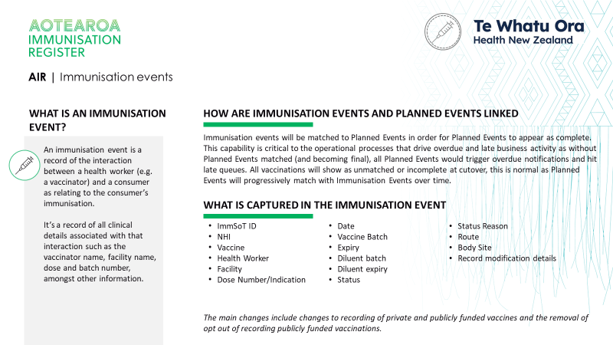
People have received vaccinations and have these interactions recorded in an immunisation register. Vaccinators are also required to keep records.
VACCINATION EVENTS
AIR | Vaccination Events
A vaccination event is a record of the interaction between a health worker (e.g., a vaccinator) and a consumer as relating to the consumer’s immunisation.
ISSUES BEING ADDRESSED
We are replacing tasks in NIR with immunisation events in the AIR; tasks were not providing the level of info required
Historically both indication and opting out have been pain points for data collection; AIR will learn from both CIR and NIR in this regard
Privately funded vaccinations have never been visible and a full view of vaccination history has been hard to obtain
WHAT IS CHANGING
Introducing immunisation events to record clinical interaction
We’re making sure that AIR contains records of all vaccinations
We will keep the function that enables you to decline events, similar to declining tasks in NIR
THE BENEFITS
We will have a clear record of the interaction between a consumer and health worker
This record includes reasons why this interaction may not have happened
We can compare what was expected to happen with what actually happened
For more on this please see cutover series session 2
*No initiative currently scopes this activity

Slide 15
AIR | Our AIR Journey
People will interact with health and vaccination services throughout their lifetime.
People have an expected set of vaccination interactions in line with the national immunisation schedule.
They are likely to need health services throughout their lifetime
A person is born in Aotearoa New Zealand.
People have received vaccinations and had these interactions recorded in an immunisation register. Vaccinators are also required to keep records
We need immunisation records to be assigned to the right person and reflective of the actual vaccination interaction that took place
MATCHING EVENTS
Against that population source we can see what immunisations people are expected to have and what they have had.
People want to know which vaccinations they have received and when

Slide 16
We need immunisation records to be assigned to the right person and reflective of the actual vaccination interaction that took place
MATCHING EVENTS
AIR | Matching Events
AIR will automatically match a Planned Event with an Immunisation Event
PLANNED EVENT | DUE
Rotavirus (dose 1 of 2) | 23 August 2023
Diphtheria, tetanus, whooping cough, polio, hep B, and Hib (dose 1 of 3) | 23 August 2023
Pneumococcal (dose 1 of 3) | 23 August 2023
ISSUES BEING ADDRESSED
The NIR currently has some data issues which can mean a great deal of manual effort to clear up
Due to tasks not being fixed it can be difficult to see what was expected to be delivered and what was actually delivered
Maia receives her 12 month immunisations, including the first dose of the rotavirus vaccine
WHAT IS CHANGING
Introducing immunisation events to record the clinical interaction & matching these to Planned Events
Introducing robust data quality rules for the matching of these records
Building a system which enables automated matching of these records where possible
MATCHING RULES
THE BENEFITS
Clear visibility of what was expected to be delivered and what was actually delivered.
Minimise administrative burden for manual matching​
Improved data quality and record accuracy.​
PLANNED EVENT | EVENT DUE | EVENT COMPLETED DATE
Rotavirus (dose 1 of 2) | 23 August 2023 | 25 August 2023
Diphtheria, tetanus, whooping cough, polio, hep B, and Hib (dose 1 of 3) | 23 August 2023 | 25 August 2023
Pneumococcal (dose 1 of 3) | 23 August 2023 | 25 August 2023
*No initiative currently scopes this activity

Slide 17
AIR | Our AIR Journey
People will interact with health and vaccination services throughout their lifetime.
People have an expected set of vaccination interactions in line with the national immunisation schedule.
They are likely to need health services throughout their lifetime
A person is born in Aotearoa New Zealand.
People have received vaccinations and had these interactions recorded in an immunisation register. Vaccinators are also required to keep records
We need immunisation records to be assigned to the right person and reflective of the actual vaccination interaction that took place
Against that population source we can see what immunisations people are expected to have and what they have had.
REPORTING
People want to know which vaccinations they have received and when

Slide 18
Against that population source we can see what immunisations people are expected to have and what they have had.
REPORTING
AIR | Reporting
The immunisation sector has a broad workforce with various needs. A unifying theme is that they need reliable and quality immunisation information to be successful.
ISSUES BEING ADDRESSED
We currently have a range of reports available through different access means, this can lead to disparate reporting.
There are currently some gaps in reporting which need to be addressed.
Reporting was not optimised to support proactive vaccination activity for example, in the case of an outbreak.
PROVIDER REPORTING
Workforce – All frontline vaccinators
When – Currently available
Platform – Vaccinator portal or integrated software i.e., PMS
WHAT IS CHANGING
Bringing reporting across to more sustainable tools such as Power BI and standardising access to reports
By ensuring that people have access to the data they need from day one with minimal operational impact
ANALYTICAL REPORTING
Workforce – All those who require analytical reports
When – Updated version available at cutover
Platform – QLIK
THE BENEFITS
Clearer visibility of vaccination data from across the motu.
Better quality data that can be updated on a more regular basis to give more accurate reporting.
A reporting suite that encourages proactive vaccination activity in a reliable manner
OPERATIONAL REPORTING
Workforce – AIR Admin, PHOs, Districts
When – Limited availability currently, full availability at cutover
Platform – Power BI
*Data sharing agreements will remain available to those groups who previously received data files
*No initiative currently scopes this activity

Slide 19
AIR | Our AIR Journey
People will interact with health and vaccination services throughout their lifetime.
People have an expected set of vaccination interactions in line with the national immunisation schedule.
They are likely to need health services throughout their lifetime
A person is born in Aotearoa New Zealand.
People have received vaccinations and had these interactions recorded in an immunisation register. Vaccinators are also required to keep records
We need immunisation records to be assigned to the right person and reflective of the actual vaccination interaction that took place
Against that population source we can see what immunisations people are expected to have and what they have had.
People want to know which vaccinations they have received and when
CONSUMER ACCESS

Slide 20
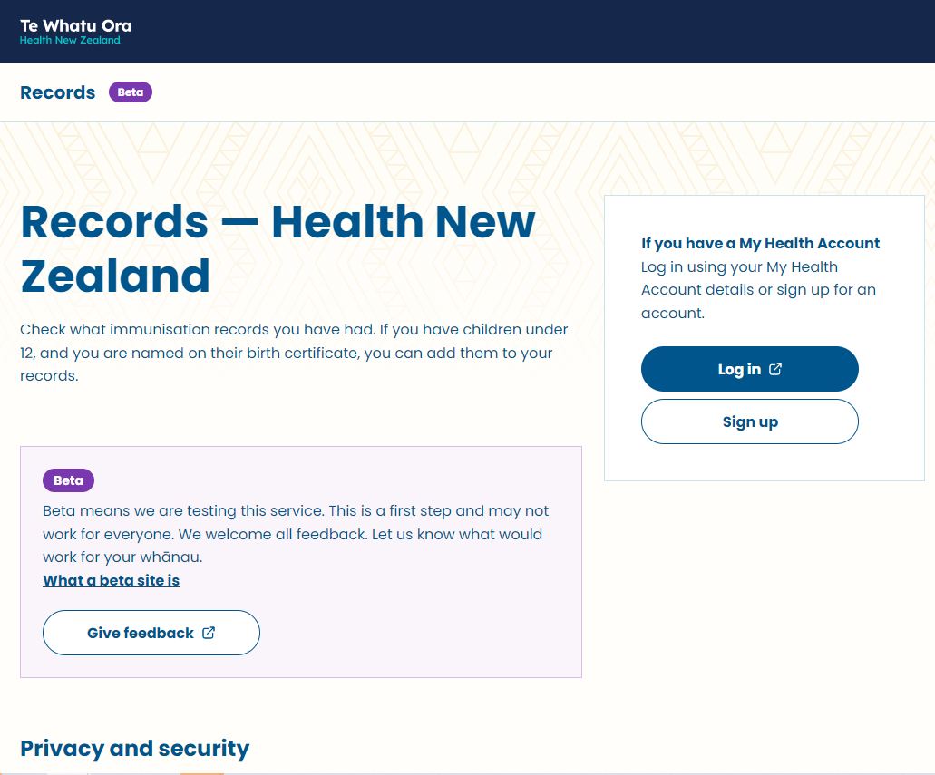
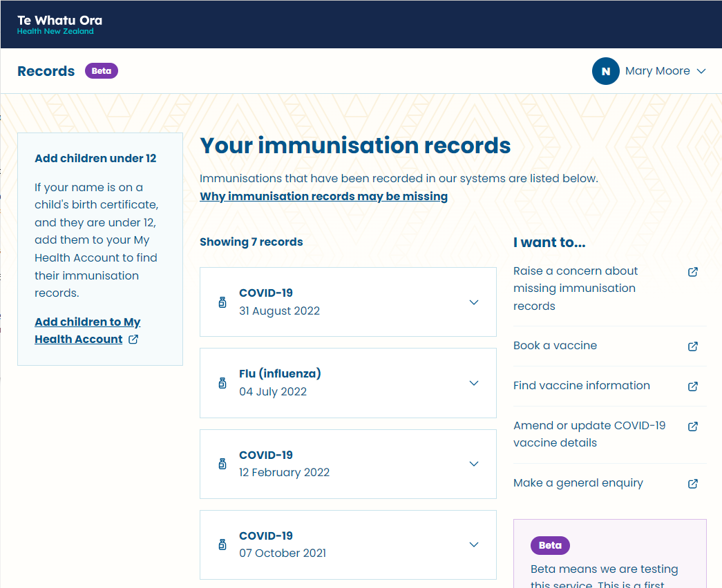
People want to know which vaccinations they have received and when
CONSUMER ACCESS
AIR | Consumer Access
We will be providing a channel (‘Records’) that ensures consumer have access to their own and their dependant’s vaccination records in a private and secure manner.
ISSUES BEING ADDRESSED
Consumers receive vaccinations from diverse providers over their lifetime and find it difficult to have a ‘joined up’ view of their own immunisation records
The current system is hard to navigate, especially for those who may not be digitally enabled
It has historically been difficult to provide information on vaccination status quickly for employment and travel
WHAT IS CHANGING
In time ‘Records’ will provide a voluntary channel for people and whānau to access their health information – it's a 'choice' to use it or not
Consumers will be able to order purpose built vaccination documentation via ‘Records’
THE BENEFITS
Access to this information is easy. People don’t need to refer to paper records, call a GP, or know where the vaccine was administered.
Knowing when vaccinations are due will empower people and whānau to better manage their health and wellbeing
*No initiative currently scopes this activity

Slide 21
Integration over time

Slide 22
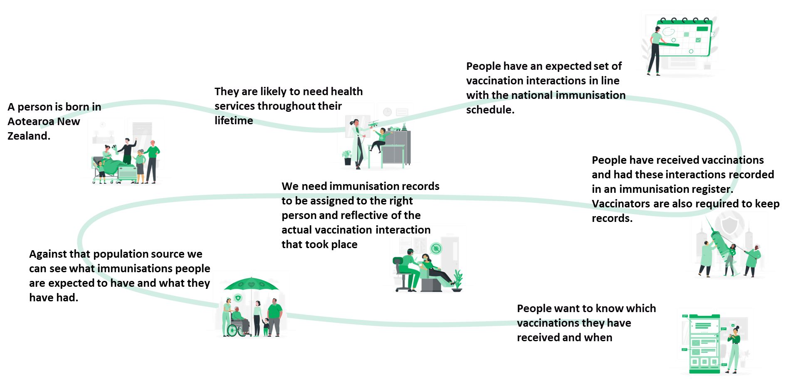
AIR | Integration
Integration is a cornerstone of AIR delivery and enables us to work alongside other technology programmes and vendors
Integration is a key component of enabling the AIR journey from beginning to end.
Integration refers to how different systems talk to one another and send messages backwards and forwards
The AIR will adopt two high level models for integration, one at cutover and one as we move through 2024
We will move from co-existence to an API based model utilising more modern technology reflective of Te Whatu Ora's direction

Slide 23
AIR Integration | Plan for Cutover
A summary of the plan for cutover is provided below.
EXISTING INTEGRATORS
NEW INTEGRATORS
AT CUTOVER
Existing messaging will move from NIR to AIR
Status queries will update from AIR instead of NIR
COVID-19 vaccinations will be managed through integrated systems.
Enrolled GP notifications will continue
The option to opt out of data collection will be removed for all vaccinations.
Continue to use existing methods for recording vaccines and reviewing vaccination history
Applications will be able to start their journey to adopting APIs
CIR users (outside of general practice) will need to onboard to AIR Immunisation Portal for recording COVID-19 immunisations
BEYOND CUTOVER
PMS suppliers will be encouraged to integrate with AIR via API
Message brokering is intended as a temporary co-existence solution
PMS suppliers may opt to subscribe to a new schedule management integration model leveraging planned immunisation events
Digital suppliers may opt to integrate with AIR via API. This could include:
Recording or updating information about a vaccination event
Reviewing a consumer’s vaccination history
Recording or updating a provider planned event

Slide 24
AIR Integration - Summary | Co-existence State
GP PMS Supplier
(existing connection)
Record immunisation event
Review history (status query)
Create/update provider planned event (reschedule)
KEY
HL7
AIR Broker
Existing Process
FHIR API
November 2023
AIR ImmSoT
(Source of Truth)
*Timeline dependent on availability in marketplace
QLIK
Data Sharing
RECORDS
NOTIFICATION TO
ENROLLED PROVIDER
Data Warehouse
(Reporting)
RECORDS
AIR Admin System
Maintain ISD users & consumers
Maintain AIR data quality
AIR Vaccinator Portal
Record immunisation event
View vaccination history including CIR and NIR

Slide 25
AIR Integration | Future State
GP PMS Supplier
(existing connection)
Record immunisation event
Review history (status query)
Create/update provider planned event (reschedule)
View all planned events for an individual
KEY
FHIR API
Existing Process
November 2023
AIR ImmSoT
(Source of Truth)
Digital Service Supplier
(new connection)*
Record immunisation event
Review history
Create/update provider planned event
View all planned events for an individual
Fast Follower (TBC)
FHIR API
*Timeline dependent on availability in marketplace
*Timeline dependent on availability in marketplace
LARGE FILE DATA SHARING AND REPORTING*
NOTIFICATION TO
ENROLLED PROVIDER
Data Warehouse
(Reporting)
RECORDS
AIR Admin System
Maintain ISD users & consumers
Maintain AIR data quality
AIR Vaccinator Portal
Record immunisation event
View vaccination history including CIR and NIR
*New direct connection - some suppliers have existing integration via data sharing

Slide 26
AIR Integration | Future State
GP PMS Supplier
(existing connection)
Record immunisation event
Review history (status query)
Create/update provider planned event (reschedule)
View all planned events for an individual
Update all enrolled consumers with latest schedule changes
KEY
FHIR API
Existing Process
PLANNED EVENT PUB/SUB MODEL
November 2023
AIR ImmSoT
(Source of Truth)
Digital Service Supplier
(new connection)*
Record immunisation event
Review history
Create/update provider planned event
View all planned events for an individual
Update all consumers with latest schedule changes
Fast Follower (TBC)
FHIR API
*Timeline dependent on availability in marketplace
Evolution (TBC)
PLANNED EVENT PUB/SUB MODEL
*Timeline dependent on availability in marketplace
LARGE FILE DATA SHARING AND REPORTING*
NOTIFICATION TO
ENROLLED PROVIDER
Data Warehouse
(Reporting)
RECORDS
AIR Admin System
Maintain ISD users & consumers
Maintain AIR data quality
AIR Vaccinator Portal
Record immunisation event
View vaccination history including CIR and NIR
*New direct connection - some suppliers have existing integration via data sharing

Slide 27
What does cutover look like?

Slide 28
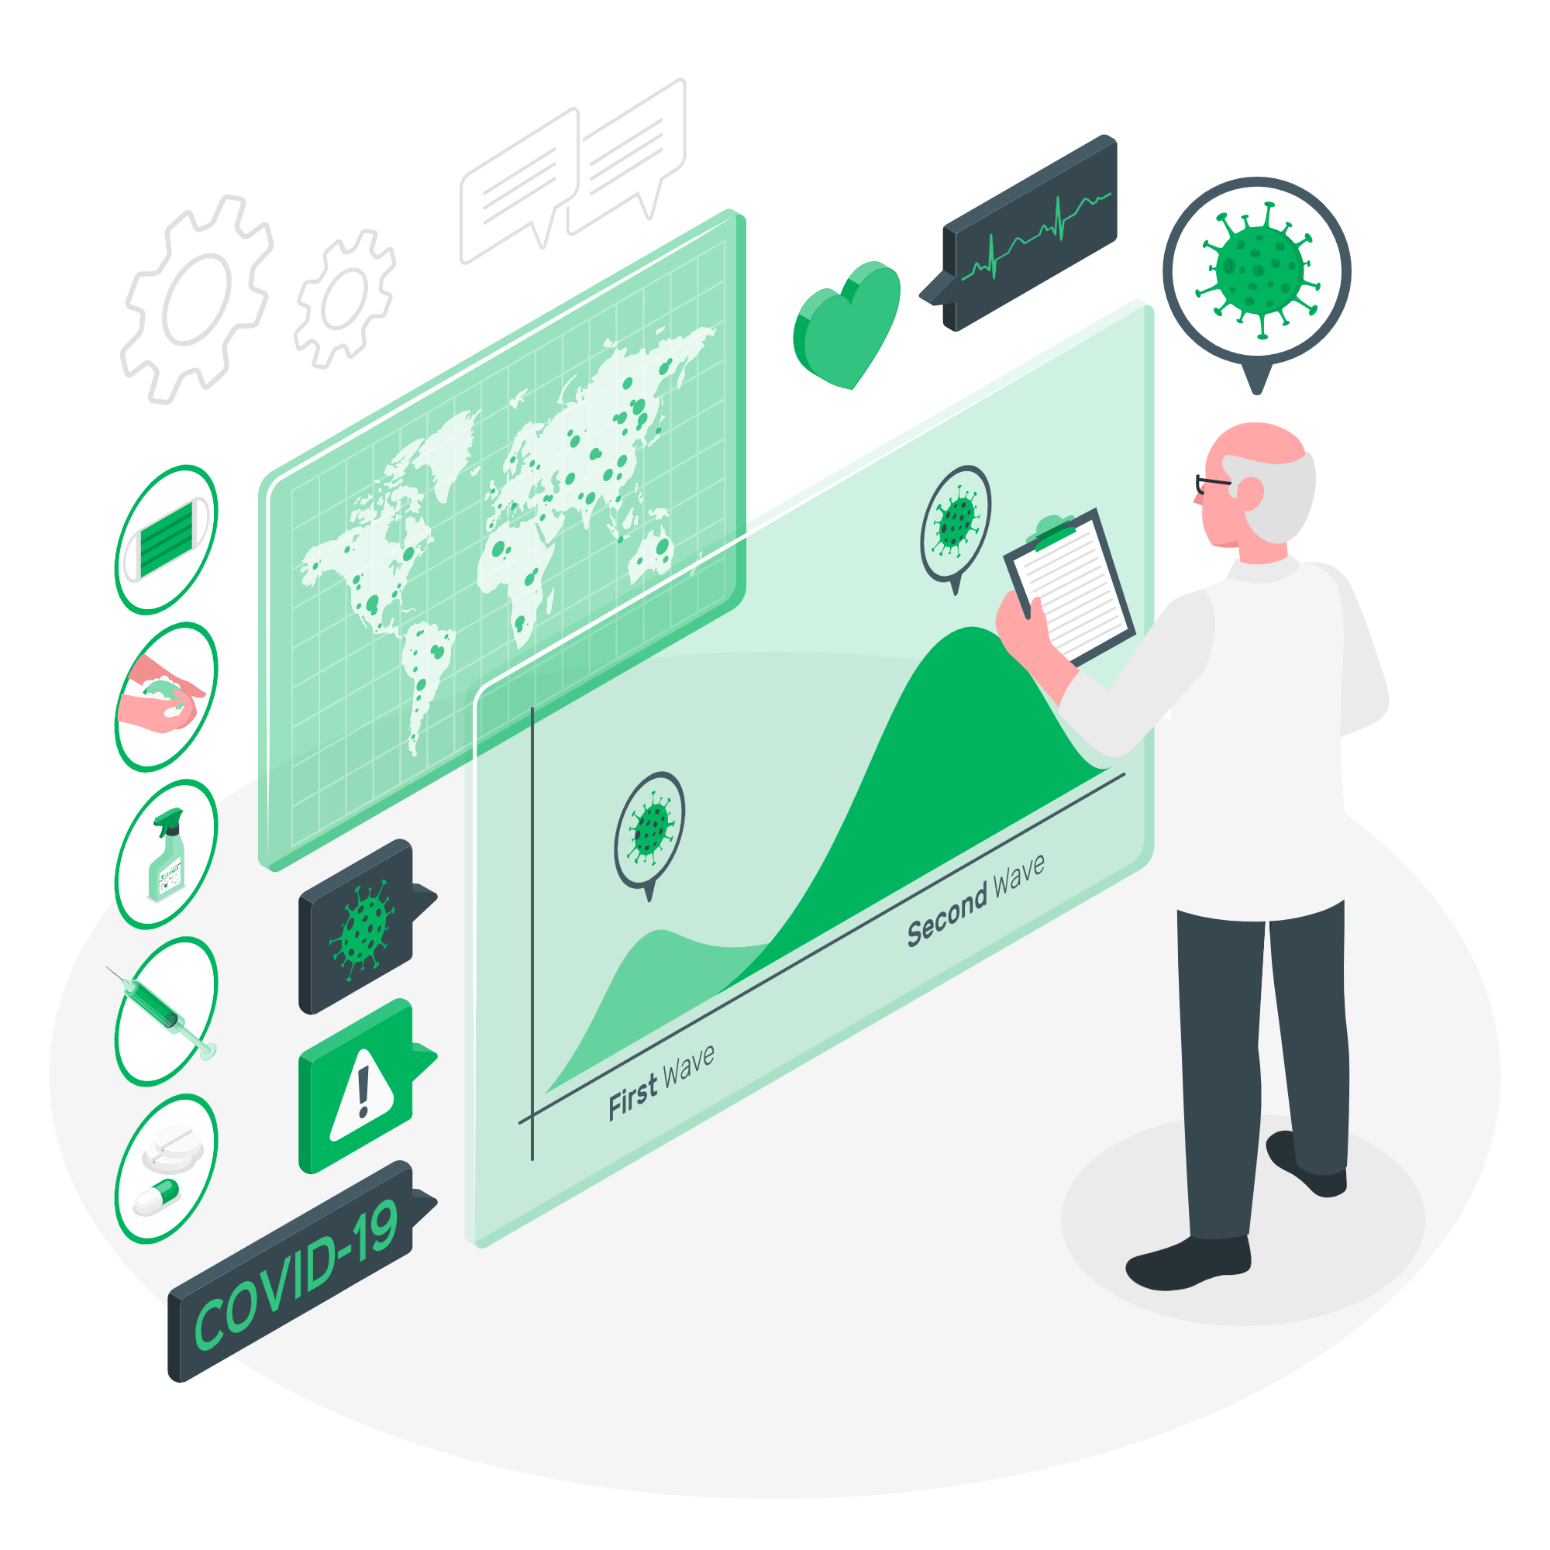
AIR Cutover | What does cutover really mean?
Cutover is a milestone when we will shift away from using the CIR and NIR and the AIR MVP will be implemented as the sole immunisation register in Aotearoa
The outcome of cutover is that:
All systems, including PMS, that currently connect to NIR will be reconnected to AIR (we are working with software vendors to enable this)
All vaccinations for all age groups will be able to be recorded in the AIR
New reporting tools will be enabled for both analytical and operational reports
Cutover refers to the AIR milestone of migrating the data from NIR and CIR and shifting all users over to use the AIR.
Cutover is currently scheduled for November 2023.
Final date is yet to be confirmed though once we have clarity this will be shared widely.
Impacts to the CIR:
COVID-19 immunisations will be recorded either via the AIR Vaccinator portal or in Practice/Patient Management Systems (PMS).
Payment for COVID-19 vaccines administered will continue to be claimed via a record being entered into the AIR.
Note there is currently no change to the way payments for other funded vaccines are claimed.
MVP = Minimum Viable Product (MVP) is a version of AIR & Whaihua with essential features that enable the transition.
AIR & Whaihua will continue to develop past MVP

Slide 29
AIR Cutover | What does this look like for a provider?
Key changes at cutover for providers are outlined below.
IMMUNISATION RECORDING | AIR will be used to record all vaccinations replacing CIR and NIR using either the vaccinator portal or an integrated system.
OPTING OFF | All vaccines will be recorded in the AIR to provide timely and accurate understanding of population immunity to mitigate risks to public health and provide complete and accurate data accessible to NZ Health providers to ensure safe and effective consumer care
REPORTING | New tools will be introduced to support reporting with a refined reporting catalogue, providers will have access to provider reporting through the vaccinator portal.
NEWBORN ENROLMENT | Providers (GP) will still receive nominations for newborn babies however this will not come from AIR but from a new foundational application to decouple this from immunisations.
PLANNED EVENTS | Planned events will replace the NIR tasks. They are the list of anticipated immunisation events reflective of the National Immunisation Schedule. They will show what a consumer is expected to have and when.
STATUS QUERY | You will be able to access an individual's vaccination history by querying records held within the AIR.
GP NOTIFICATIONS | GP Practices will continue to receive notifications to their PMS for enrolled patients when they receive a vaccination elsewhere. But will not receive automated overdue notifications.

Slide 30
AIR Cutover | What does this look like for a district?
Key changes at cutover for districts are outlined below.
REPORTING | New tools will be introduced to support reporting with a refined reporting catalogue, people will continue to have access to the information they need.
NEWBORN ENROLMENT | Newborn pre-enrolment will be managed through an independent application, called Whaihua
PLANNED EVENTS | Planned events will replace the NIR tasks. They are the list of anticipated immunisation events reflective of the National Immunisation Schedule. They will show what a consumer is expected to have and when.
OUTREACH | Introduction of a new application to support Outreach activity, called Whaihua
DEVOLVED ONBOARDING | To use the AIR Vaccinator Portal each site must have a 'facility manager' who can verify the identity and approve access to use AIR on their site.

Slide 31
AIR|For more information
Where to go for more information
Te Whatu Ora webpage with AIR updates
Home / Our health system / Digital Health / The Aotearoa Immunisation Register (AIR) or Search for ‘AIR’
Send any questions or feedback to air.engagement@health.govt.nz

