Slide 1
HHCApp
Auditors

Slide 2
Session Objectives
How to login
Update profile
Outline the use of HHCApp
Options for data entry
Mobile devices

Slide 3
How to Log in to HHCApp
Your lead hand hygiene person will provide your username and password
First login should be on a computer
Login is case sensitive
Password requires one capital
Forgotten password function requires
Username
Email attached to profile

Slide 4
HHCApp Website
For the computer version:
http://hhcapp.hha.org.au

Slide 5
Auditor Role
Roles for Auditors in HHCApp:
Enter data only
When logged in as an Auditor, the home page will look like:

Slide 6
Auditor Home Page

Slide 7
Auditor Home Page
Previously entered data
Add new data here

Slide 8
Update HHCApp Profile
Click on your name in the top right hand corner to update your profile

Slide 9
Update HHCApp Profile

Slide 10
How to enter data
If data is collected on paper
Login to HHCApp
From the auditor home page
Click on Add Session

Slide 11
Add New Session
Enter the details of the session

Slide 12
Add New Session
Enter the details of the session
Select the organisation name

Slide 13
Add New Session
Enter the details of the session
Choose an audit
NHHI Audit
OR
Local Audit

Slide 14
Add New Session
Enter the details of the session
Choose a ward / department

Slide 15
Add New Session
Enter the details of the session
Session number is optional.
Use this only if you are keeping a running tally on paper of sessions for each department

Slide 16
Add New Session
Enter the details of the session
Dates and times to be entered as per paper audit sheet

Slide 17
Add New Session
Enter the details of the session
Once completed press save

Slide 18
Entering Moments
Once the session information has been saved you will see the fields for moment data entry

Slide 19
Entering Moments
Set up for quick keyboard entry
Use starting letter / number and tab key to select and move between fields
You can also use the mouse to click the dropdown boxes and select the required field

Slide 20
Entering Moments
The running tally of moments is updated each time a moment is saved
Ensure this matches the totals on your paper audit

Slide 21
Entering Moments
When you have finished just navigate away from the page using the menus
No need to click save again unless you have changed any of the session information since you last saved it.

Slide 22
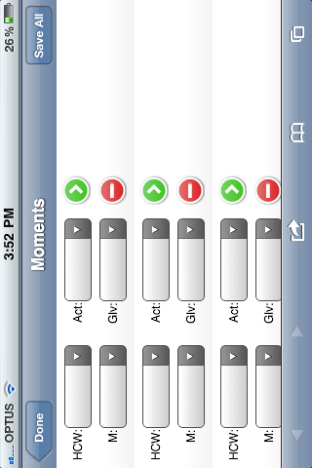
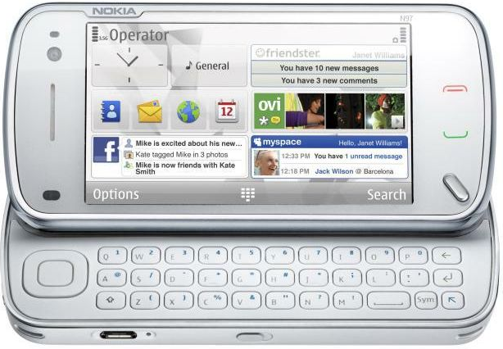
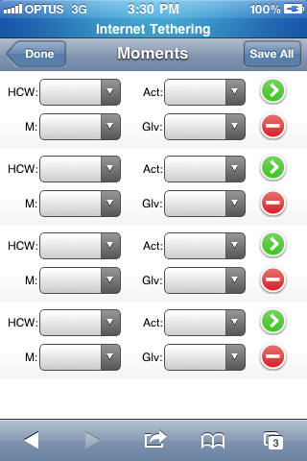
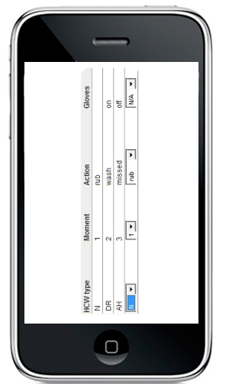
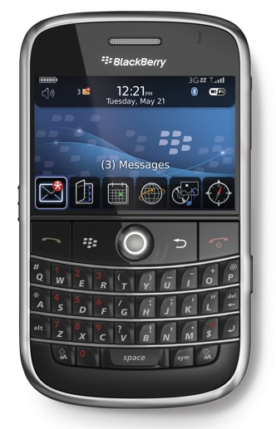
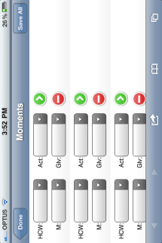
Direct web entry from enabled devices

Slide 23
Direct web entry
Minimal data usage on your plan
Syncing 100 moments = 650 bytes
Most data plans are in gigabytes
1GB = 1 billion bytes
Wifi to login and sync only
Potential to claim your mobile usage for work on tax

Slide 24
Use a mobile device!
Cut data entry time by half
Have less data entry errors
Allow multiple auditors to enter data at once
More discrete data collection

Slide 25
Direct web entry from enabled devices
Can be accessed via the internet browser on your device (Apple or Android)
Web address is http://hhcapp.hha.org.au/mobile/
The device only needs to be connected to the internet or the first time you login and when you “Sync” your completed session(s)
You must use your personal username to login

Slide 26
Practice with Mobiles
http://hhcapp.hha.org.au/mobile/
Username and password fields are case sensitive so capitals are important
Username: Ignaz
Password: Ignaz1

Slide 27
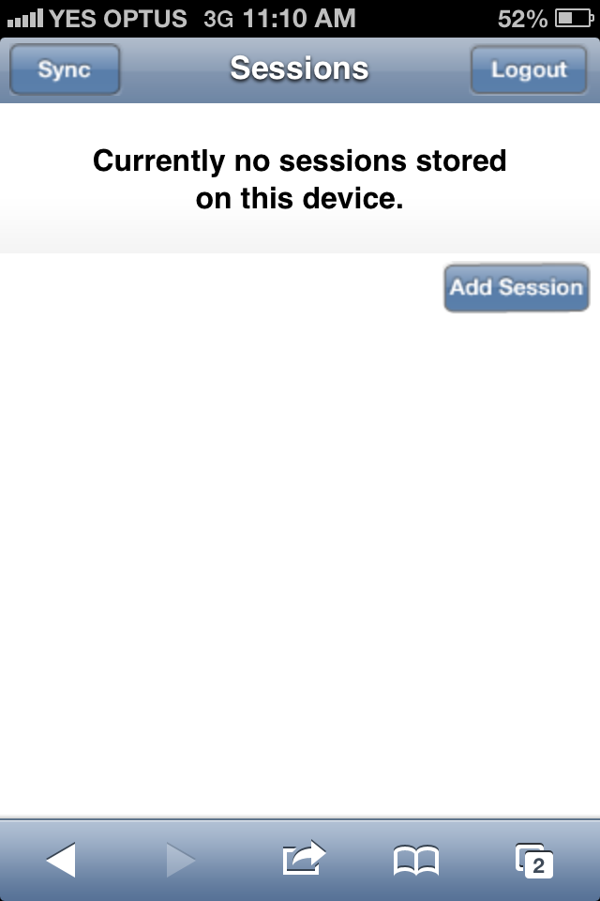
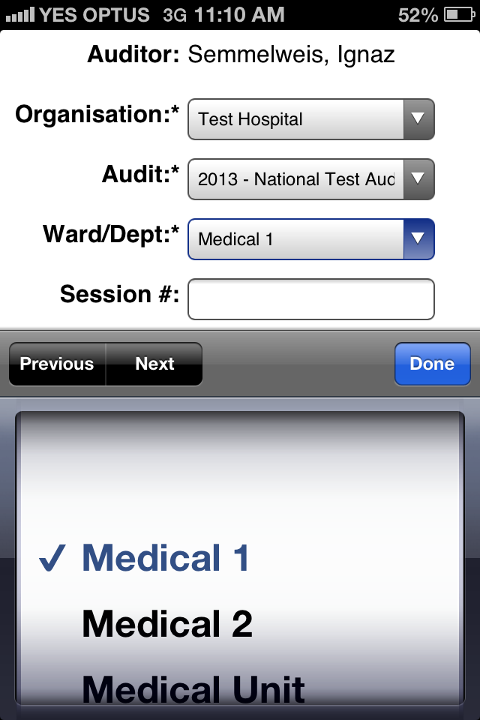
Log In
Login with your personalised login
Add data by pressing Add Session
Choose the audit and dept you are going to start auditing on
Notes:
Select Add Session to start a new session
Select the required session information

Slide 28
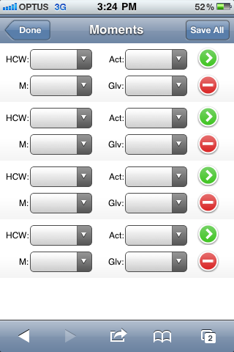
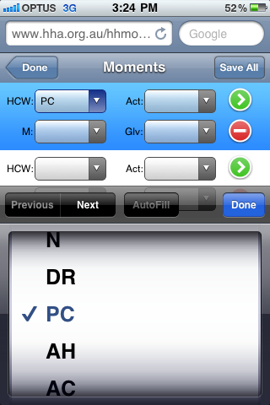
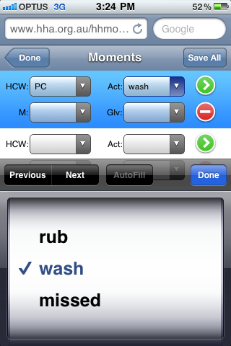
Enter HH data
This page is like the paper data form
Fill in the moment data:
HCW, Action, Moment, Gloves
Notes:
Select the required values

Slide 29
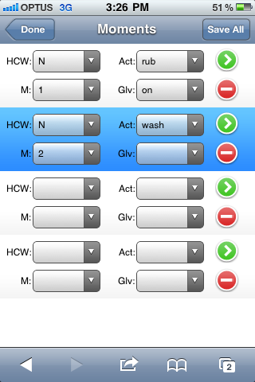
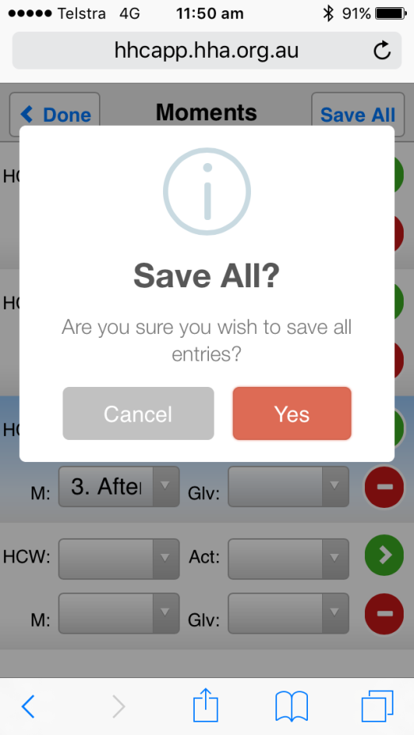
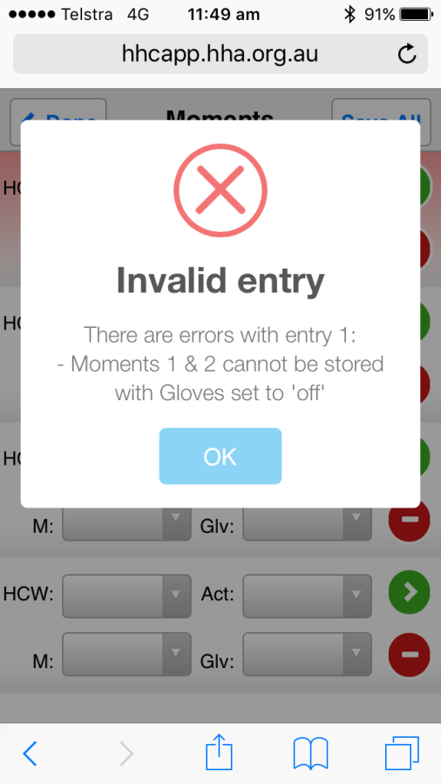
Save Data
Save all moments by using Save All
Save one moment at a time by using the green arrow
Data validation rules assist with accurate data collection
Notes:
Two options for saving and clearing a completed moment
Select the green arrow next to the completed moment to save the single entry; or
Select Save All to save all the completed moments
Any moments that have errors will be highlighted in red with an error message explaining what is wrong
When your session is completed, select done

Slide 30
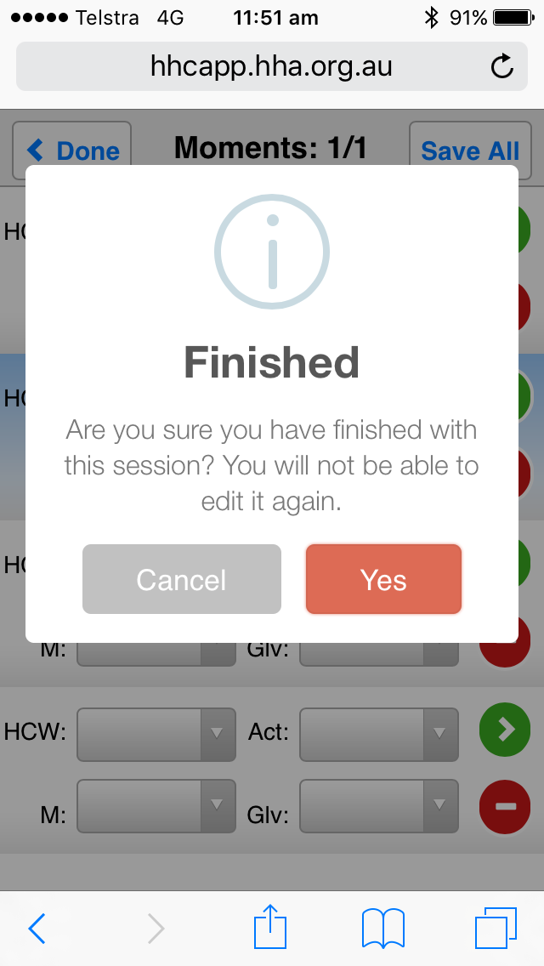
Finish Collecting Data on One Ward
Finished collecting data – press Done
Notes:
Two options for saving and clearing a completed moment
Select the green arrow next to the completed moment to save the single entry; or
Select Save All to save all the completed moments
Any moments that have errors will be highlighted in red with an error message explaining what is wrong
When your session is completed, select done

Slide 31
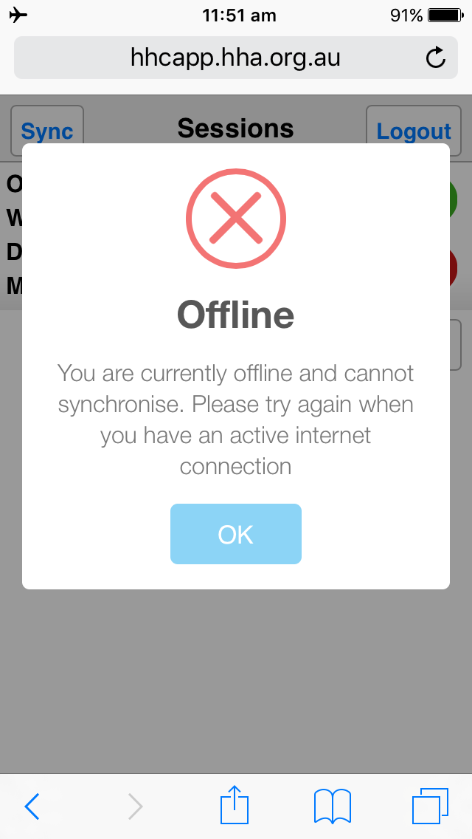
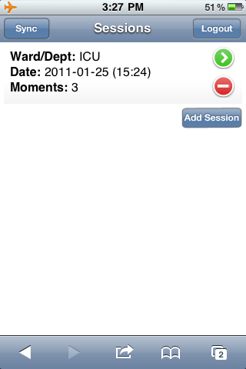
Syncing data
Finished data collection session on one ward – sync data with database before collecting more data
Need to be connected to the internet to enable syncing with the database
Notes:
Now on the sessions screen will be the completed session ready to be “Synced” to HHCApp
If you are offline you won’t be able to sync the session
If you are online, the session will be cleared from your device

Slide 32
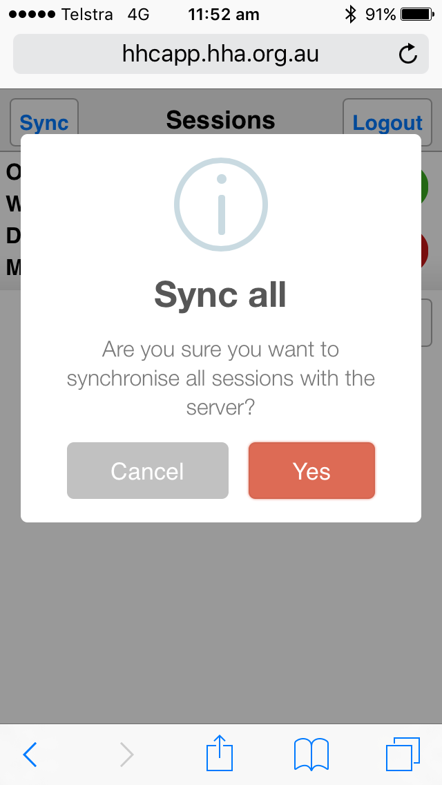
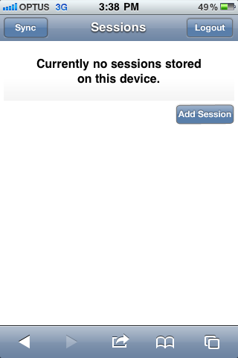
Syncing data
Sync was successful if you return to this page

Slide 33
Always Log Out
After you have finished data collection and you have synced your data ensure that you LOG OUT
Closing the internet browser does not log you out

Slide 34
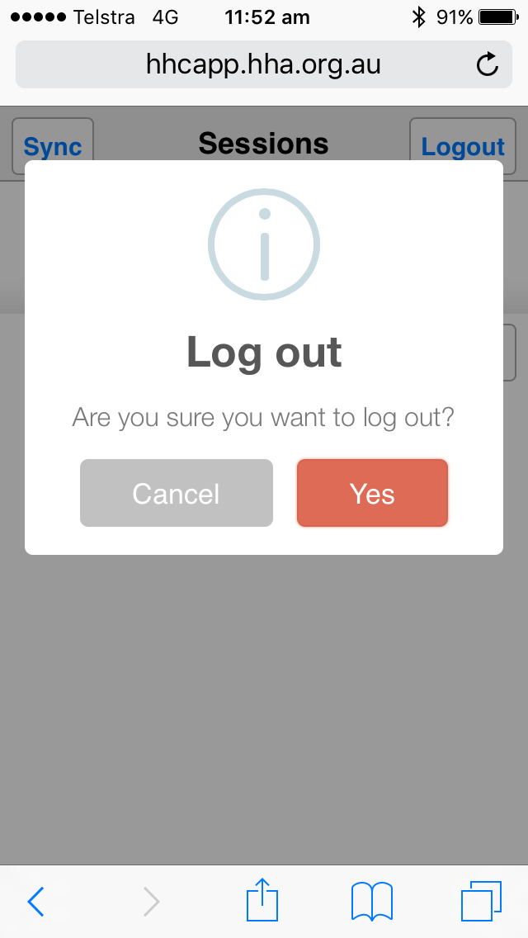
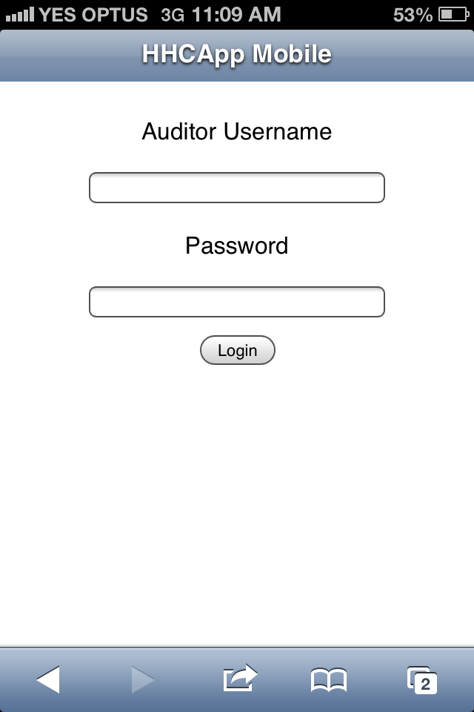
Correct Log out
Logging out successfully returns you to the login page
Log out by pressing the Logout button

Slide 35
HHCApp Instructions
The written instructions are the best resource to learn how to use HHCApp
These can be accessed via the HHA website on the Hand Hygiene Compliance Application page.
http://hha.org.au/HHComplianceSystem.aspx
They cover data entry for HHCApp in a simple step-by-step manner
HHA are also available for assistance when required

Slide 36
Instructions Sheets for Auditors
How to add sessions on a desktop
http://hha.org.au/UserFiles/file/HHCApp/NewHHCApp-AddingASession.pdf
How to add sessions on a mobile device
http://hha.org.au/UserFiles/file/HHCApp/NewHHCApp-MobileDevice.pdf

Slide 37
Instructions Sheets for Auditors
Troubleshooting Guide – Apple
http://hha.org.au/UserFiles/file/HHCApp/HHCAppTrouble%20Shooting%20Guide_Apple%20Devices_Final.pdf
Troubleshooting Guide – Android
http://hha.org.au/UserFiles/file/HHCApp/HHCAppTrouble%20Shooting%20Guide_Android%20Devices.pdf

Slide 38
Data Collection Tools
Paper based audit tools
http://hha.org.au/ForHealthcareWorkers/auditing.aspx
HHA Manual and Practice Guidelines
http://hha.org.au/ForHealthcareWorkers/manual.aspx

