Slide 1










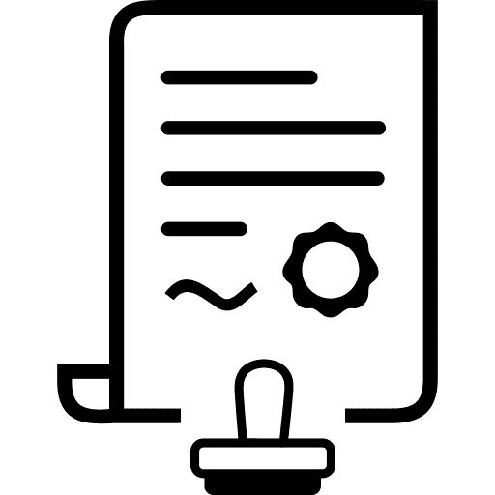



Digital Subscriber Onboarding- High-level process
>>> Access to Digital Asset’s Mock+ or UAT Environments for the <<<
Pre-Registration
Important documents to read before you register your organisation
APIs currently available on Digital Services Hub
Register Your Organisation
Register your organisation to the Developer Portal
When registering, please ensure that your Full Name, Middle Name, and Last Name exactly match what appears on the identity document you’ll be using in the next step.
User Sign-up Receive email invitation to sign up on Developer Portal. Sign up via My Health Account Workforce Login here and increase your identification to Level 2.
About My Health Account Workforce
Identity Documents required for My Health Account Workforce Sign up
Developer Portal Access
Log into Developer Portal via My Health Account Workforce
One-time submission: these forms only need to be completed once per organisation and product:
Organisation Risk
Product Registration
Product Risk
Request Access to Mock+ or UAT
Submit your request to access Mock+ or UAT credentials for the digital asset you intend to integrate with
Request access to a Digital Asset
Review and Share Credentials
The Digital Services Hub and internal teams will review your organisation, product risk, and access request. If everything is in order, UAT credentials for the requested API will be issued.
Compliance Test Ready
Subscriber informs DSH via Request Access Comments that they are Ready for Compliance Test.
It’s essential that the subscriber has completed all prerequisite documentation and internal validations before signaling readiness.
Compliance Testing
DSH initiates the compliance validation process.
This includes technical checks on use cases specified, policy alignment, and any required sandbox testing.
Timely responses from the subscriber during this phase can significantly reduce turnaround time.
Product Certified
Once compliance is passed and agreements are in place, the subscriber’s products are officially certified. This milestone unlocks the ability to proceed to release planning.
Pending Agreements
Legal and commercial agreements are now in motion. This step often runs in parallel with compliance testing and may involve negotiation or clarification of terms.
Ready for End user Onboarding
All systems are go.
The subscriber has completed all technical, legal, and operational requirements.
Internal teams begin preparing for deployment, including final validation and scheduling.

