Slide 1
Information for presenter/employer
This presentation has been created to support managers or team leaders to teach non-clinical and/or non-regulated workforce about assisted dying. This may include receptionists, cleaners, support workers, carers or health care assistants.
The presentation will take around 20 minutes to deliver. It is strongly recommended that the person delivering the presentation completes the End of Life Choice Act 2019: Overview e-learning module as preparation. All regulated health staff are encouraged to complete this module.
A few considerations for using this presentation:
What is the best time and setting to deliver this presentation, such as when patients/clients/residents and their families are not around?
How can you help facilitate an open and safe space for learners to share questions or concerns? For example, some staff may prefer to talk one on one rather than in a group setting.
What preparations or planning has your organisation done for assisted dying, and how can this be incorporated into the presentation?
What is the most appropriate response for your staff if someone raises assisted dying with them? For example, it might be appropriate for a support worker to help find more information or make a doctor’s appointment for the person, or for a health care assistant to notify a registered health practitioner within your team.
Further information to help answer questions or provide additional information can be found on the Ministry’s website.

Slide 2
  Assisted dying services
  What this means for your workplace

Slide 3
  What is this presentation about?
  This presentation is to help you understand and think about what assisted dying may mean for your workplace.
  As someone working in a health or disability organisation you may be asked about assisted dying.
  Someone you care for or support may choose to access assisted dying services.

Slide 4
What is assisted dying?
You may remember being given the option to vote in a referendum at the 2020 election on whether assisted dying should become legal.
The referendum received majority support – 65%.
This means assisted dying will become legal on 7 November 2021.
Assisted dying means a person who is terminally ill and meets specific criteria can ask for medical assistance to end their life.

Slide 5
  Who is eligible for assisted dying?
  There is a specific set of criteria a person must meet to be eligible to choose an assisted death.
  A person cannot have an assisted death solely because they are suffering from a mental illness, a disability or are old.

Slide 6
  Who is eligible for assisted dying?
  A person must:
  Be aged 18 years or over
  Be a citizen or permanent resident of New Zealand
  Have a terminal illness that is likely to end their life within six months
  Be in a state of physical decline that cannot be reversed
  Be suffering in a way that the person feels other treatment will not make it okay
  Be able to make an informed decision about assisted dying.

Slide 7
Requesting assisted dying
A person must ask for assisted dying themselves, and they should raise this with their doctor.
A person may ask you about assisted dying. This might be because they want more information, or they might be considering this option.

Slide 8
  What do I do if someone asks me about assisted dying?
  If someone asks you about assisted dying you should respond respectfully and professionally, whatever your personal beliefs.
  You should tell the person that this is something they can talk to their doctor about. You should also tell your manager or a registered health professional that the person has asked you about assisted dying.
  You might want to practice having a conversation like this with a friend, family member or a colleague so you are prepared with what you might say.

Slide 9
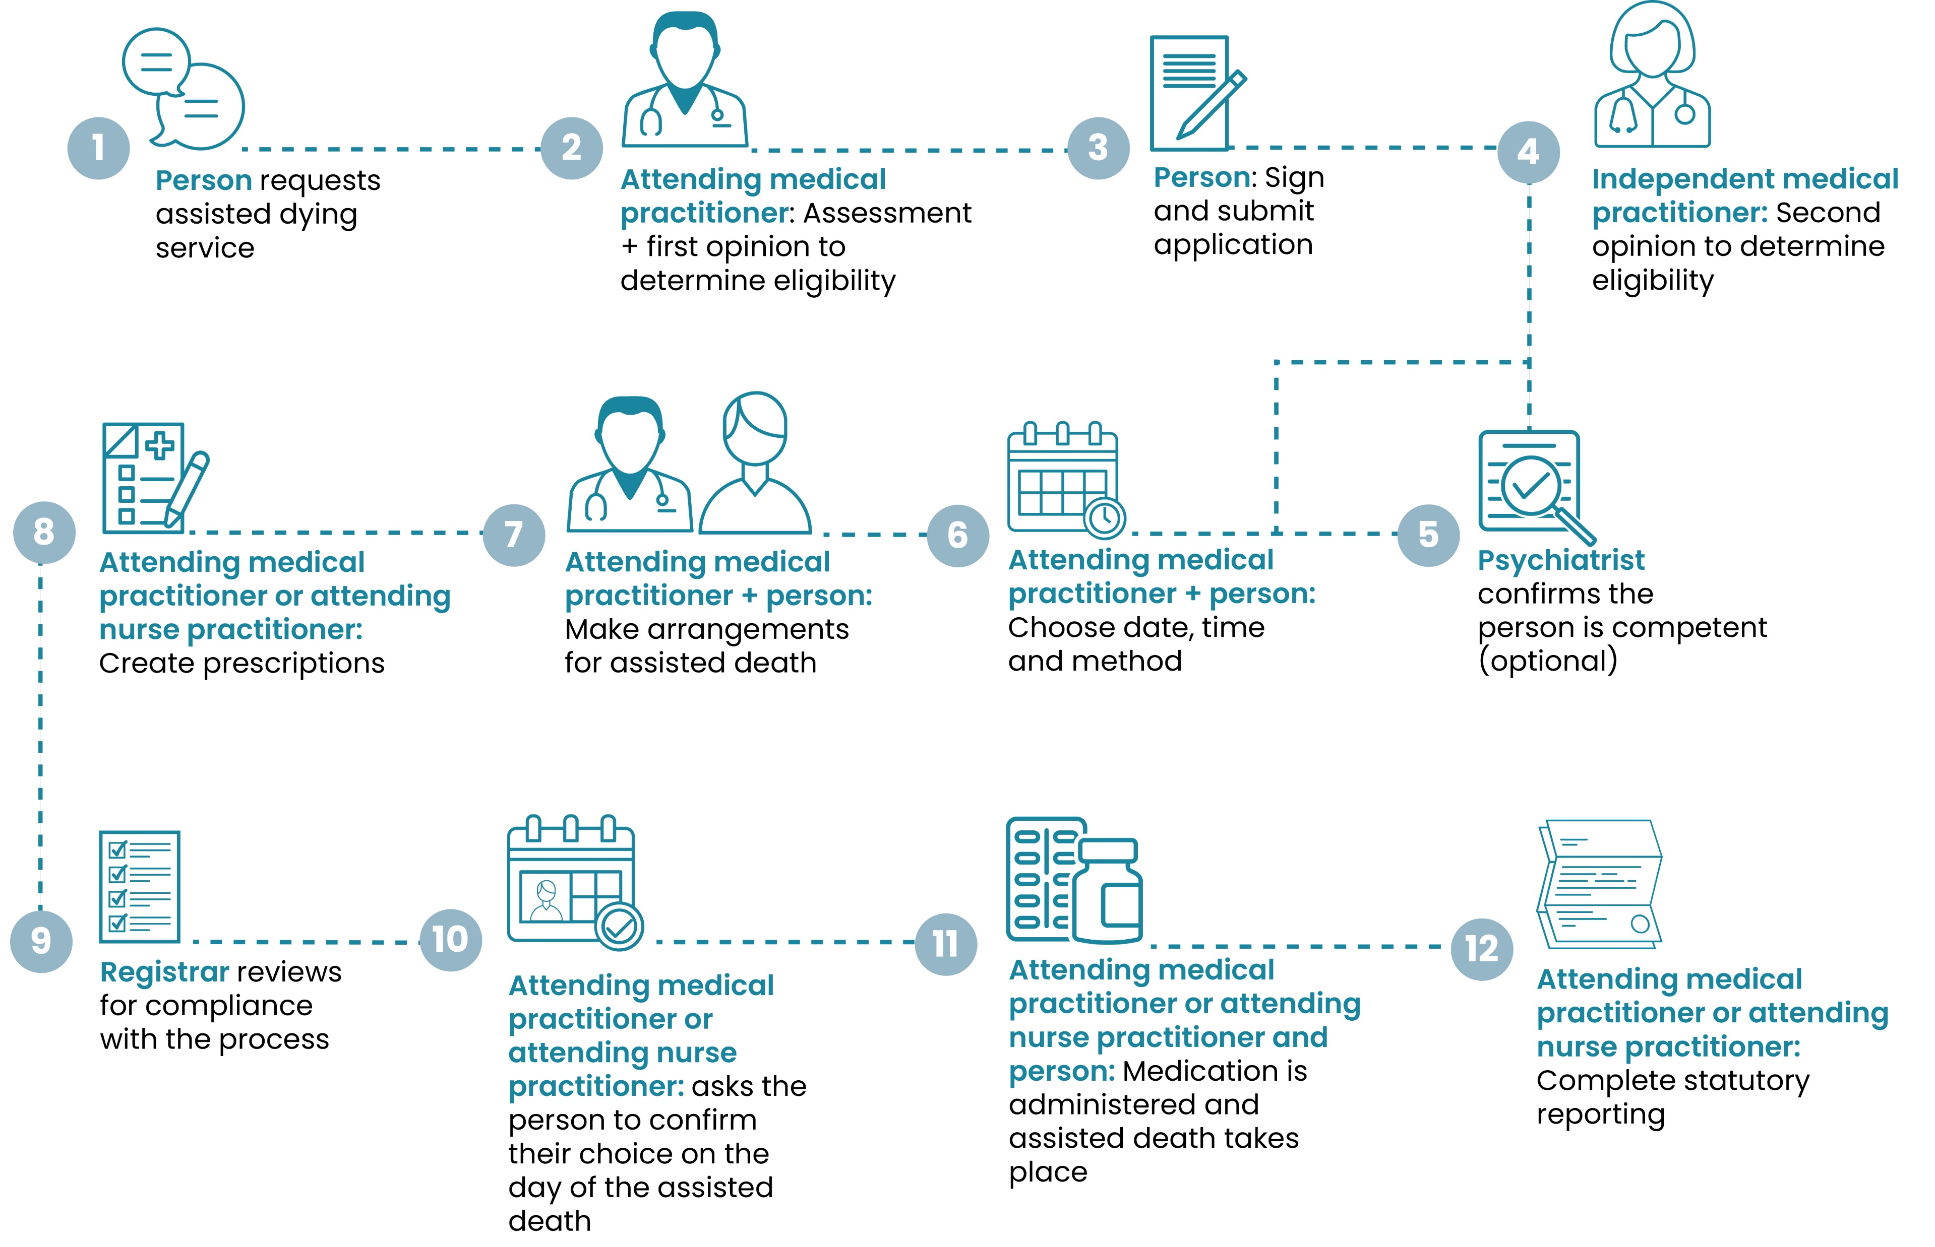
What is the process for choosing assisted dying?
There are a number of steps that must be followed.

Slide 10
  How is a person kept safe when choosing assisted dying?
  A person must understand all of their options for end of life care, such as palliative care.
  A person must demonstrate they are able to make an informed choice about assisted dying.
  A person must not be pressured into choosing assisted dying by someone else.
  A person can change their mind at any time and must be aware of this option.

Slide 11
  How might I be involved in assisted dying services?
  If a person you care for or support chooses assisted dying, there may be some other ways you are involved depending on your role and organisation.
  Being present at appointments related to assisted dying.
  Helping a person or whānau make practical arrangements for an assisted death, such as where it may take place.
  Being present and providing comfort care to the person and supporting their whānau at the time of the assisted death.
  Providing post-death care or support to a person and their whānau following an assisted death.

Slide 12
  Do I have to be involved in assisted dying services ?
  You do not have to be involved in assisted dying services if you do not agree due to your personal beliefs (conscientious objection).
  It is important that you act respectfully and professionally if someone you care for or support asks your about or chooses assisted dying.
  You must not stop someone you care for or support from getting access to assisted dying services or any other health care.
  It is helpful to tell your manager if you do not agree with assisted dying due to personal beliefs. Your manager will work out how to manage assisted dying requests and support within the organisation and respect staff’s wishes not to be involved.

Slide 13
  Key points to remember
  Assisted dying will be legal from 7 November 2021. Only people with a terminal illness who meet strict criteria will be able to get help to end their lives.
  A person you care for or support may ask you about assisted dying. You must not raise assisted dying with someone.
  You do not have to be involved in assisted dying services, but you should respond respectfully and professionally, whatever your beliefs.

Slide 14
  What happens next?
  You might want to talk to your colleagues or manager about assisted dying. These conversations can be helpful to help you feel prepared for if a person you care for or support asks about assisted dying or chooses to have an assisted death.
  Assisted dying can be a sensitive topic and talking about it may be difficult for some people. If you want to talk to someone about how you are feeling, you can call or text 1737 to speak to a trained counsellor at any time.
  If you are unsure about what assisted dying means for you and your role, or you ever feel uncomfortable with something someone asks you, you should talk to your manager.

Slide 15
  Any questions?

